Slide 1
TEACHER CERTIFICATION UPDATE
Dr. Deborah A. Gibson
Academic Services Officer
Wayne State University
August 19, 2022
Notes:
Good morning,
Council of Chief Negotiators, Council for Academic Leadership, Metro Bureau, Teachers and Colleagues. My name is Deborah Gibson, and I am the Certification Officer for Wayne State University’s College of Education. Today I will present information regarding Teacher Certification.

Slide 2
This presentation will cover…
  Current Educator Certificate Requirements (professional learning)
  Pending Changes
      Grade Bands
  Alternative Path to Certification
Notes:
My presentation will cover the following:
1. The Current Educator Certificate Requirements. This will include information on professional learning options.
2. I will also discuss the changes and pending changes to the Certification structure
3. Then finally a quick overview of an Alternative Path to Certification

Slide 3
Current Teacher Certification Requirements
  Initial Educator Certification
  Standard Teaching Certificate Renewal
  Progressing to the Professional Teaching Certificate
  Professional Teaching Certificate Renewal
  Advanced Professional Teaching Certificate
  Advanced Professional Teaching Certificate Renewal
Notes:
Regarding current teacher certification rules, I will cover initial standard, standard renewal, progressing to the professional, professional renewal, advanced professional and advanced professional renewal requirements.

Slide 4
Initial Standard Educator Certification
  Complete an approved educator prep program
  Hold at least a bachelor’s degree
  Complete reading methods (6 hours for elementary teachers & 3 hours for secondary teachers)
  Complete approved first aid and cardiopulmonary resuscitation (CPR)
  Pass appropriate Michigan Test for Teacher Certification (MTTC)
NOTE: The Standard Teaching Certificate is a five-year teaching certificate with unlimited renewals.
Notes:
Michigan law and rules require that all individuals complete an approved teacher preparation program in order to become a teacher in Michigan. In addition to holding at least a bachelor's degree, Michigan law requires that teachers complete reading methods (this is built into the teacher preparation program), MDE approved First Aid and CPR courses, and passage of the appropriate Michigan Test for Teacher Certification (MTTC). The initial standard certificate is a five-year certificate with unlimited renewals.

Slide 5
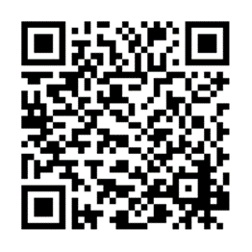
Standard Teaching Certificate Renewal
  Each renewal adds five years to the certificate’s validity.
  Renewal requests can be as early as January 1 of the expiration year.
  Requirements - One of the following:
    150 hours of Education Related Professional Learning (ERPL)
      State Continuing Education Clock Hours (SCECHs)
      District Provided Professional Development (DPPD)
      College semester hours (1 semester hour = 25 ERPL)
    An education-related masters or higher degree earned at any time
NOTE: The master’s degree of higher may be used one time to renew the Standard Teaching Certificate.
Certificate Renewal Process
Notes:
Speaking of renewals, the standard certificate renewal lasts five years and requires the following:
150 hours of Education Related Professional Learning (ERPL) This can take the form of SCECHS, DPPDs or College Semester hours Please note, one college semester hour equals 25 ERPLs
An education related masters of higher (the degree can be earned at anytime and can only be used once to renew the standard teaching certificate).
On the side of this slide is a QR code that will take you directly to the Michigan Department of Education (MDE) requirements webpage.

Slide 6
Progressing to the Professional Teaching Certificate
  Three years of certified teaching experience
  Reading methods
  3 semester hours of reading diagnostics & remediation
  150 hours of Education-Related Professional Learning (ERPL); or An education-related master’s or higher degree
  Effectiveness ratings* in accordance with MCL 380.1531j:
    Consecutive: effective or highly effective ratings
    Nonconsecutive: effective or highly effective ratings performance evaluation for at least 3 nonconsecutive school years
Notes:
For those interested in progressing to the Professional Teaching Certificate, note, to be eligible, the teacher must have the following:
1. 3 yrs. teaching since the date of the initial certificate within the content areas and grade level of the Teaching Certificate; and
2. Reading methods (6 hours for elementary teachers & 3 hours for secondary teachers)-This would have been met during the teacher prep program
3. 3 semester hours of reading diagnostics and remediation, which includes a field experience.
4. 150 hours of Education-Related Professional Learning; or An education-related master’s or higher degree earned at any time (even if previously utilized to renew the Standard Teaching Certificate)
5. Effectiveness ratings* in accordance with MCL 380.1531j:
A) Consecutive: effective or highly effective ratings the performance evaluations for the 3 consecutive school years prior to the Professional Teaching Certificate; or
B) Nonconsecutive: effective or highly effective ratings performance evaluation for at least 3 nonconsecutive school years prior to applying for the Professional Teaching Certificate, an Effective Educator Recommendation form completed by the chief school administrator.

Slide 7
Professional Teaching Certificate Renewal
Requirements (One of the following):
  Education-Related Professional Learning totaling 150 hours.
  A valid out-of-state teaching certificate, appropriate for K-12 education may be used one time.
Notes:
For those renewing the Professional Teaching Certificate, please note that applicants must have the following:
1. Education-Related Professional Learning totaling 150 hours.
2. For those transferring from out of state: A valid out-of-state teaching certificate, appropriate for K-12 education may be used one time.

Slide 8
Advanced Professional Teaching Certificate
  A Professional Teaching Certificate
  Complete approved Michigan Teacher Leader program or certification through the National Board for Professional Teaching Standards
  Teacher Leader or National Board designation must be noted on the certificate prior to submitting application for an Advanced Professional Teaching Certificate
  3 Highly effective ratings
  No ineffective ratings
  NOTE: For additional information on educator evaluations and ratings: educator evaluations website or email questions to MDE-EdEvals@Michigan.gov.
Notes:
Teachers seeking to obtain the Advanced Professional Teaching Certificate must have the following:
1. A Professional Teaching Certificate
2. Complete approved Michigan Teacher Leader program or certification through the National Board for Professional Teaching Standards
3. Teacher Leader or National Board designation must be noted on the certificate prior to submitting application for an Advanced Professional Teaching Certificate
4. Highly effective ratings for 3 out of the 5 most recent end-of-school-year annual evaluations under MCL 380.1249
5. No ineffective ratings within the 5 most recent end-of-school-year annual evaluations under MCL 380.1249
NOTE: For additional information on educator evaluations and ratings, please visit the educator evaluations website or email questions to MDE-EdEvals@Michigan.gov.

Slide 9
Advanced Professional Teaching Certificate Renewal
  Highly Effective rating for 3 out of 5
  No Ineffective ratings
  150 ERPL hours
  NOTE: Any teachers unable to meet the APC renewal requirements may return to the Professional Teaching Certificate.
Notes:
Teachers seeking to renew the Advanced Professional Teaching Certificate must have the following:
Highly Effective rating for 3 out of the 5 most recent end-of-school-year annual evaluations
No Ineffective ratings within the 5 most recent end-of-school-year annual evaluations
150 Education-Related Professional Learning hours.
NOTE: Any teachers unable to meet the APC renewal requirements may return to the Professional Teaching Certificate.

Slide 10
Substitute Permits
  Four Types of Permits:
  • Daily Substitute Permit (initial and extension)
  • Full-Year BASIC Substitute Permit
  • Full-Year SHORTAGE Substitute Permit
  • Full-Year Expert Substitute Permit
  Note: Similar to the permit, there are Special Education Approvals
Notes:
As Administrators and Human Resources representatives, there are times you must hire teachers without the appropriate endorsement or certificate.
Michigan law requires schools to hire and employ properly certified and endorsed teachers. To systematically address needed exceptions to law, the Michigan Department of Education (MDE) has established administrative rules to authorize permits. A school district or nonpublic school shall obtain the appropriate permit, authorization, or approval to employ an individual or teacher who does not hold the valid and appropriate endorsement or certificate. Here are four types of permits.
1.The Daily Permit is used for INTERMITTENT daily substitute assignments when a teacher is temporarily unavailable. It requires at least 60 semester hours of satisfactory credit (grade ‘C’ or better) combined from one or more regionally accredited two- or four-year colleges or universities. It is limited in a single teaching assignment to no more than 90-calendar days.
2. The Full-Year Basic requires at least 60 semester hours of satisfactory credit (grade ‘C’ or better) combined from one or more regionally accredited two- or four-year colleges or universities. If the assignment is in a core discipline area, the individual must have a corresponding major (or equivalent of 30 semester hours in the content area) on the transcript or passing scores on the state approved discipline area test. It requires the district/school to assign a mentor teacher. It can be renewed.
3. The Full-Year SHORTAGE is only approved up to 0.5 FTE per teacher. It requires the teacher to hold a Michigan Professional, Advanced Professional Teaching, Permanent, Life or Continuing Certificate. If the assignment is in a core subject area, the individual must have a corresponding major or passing scores on the state approved subject area test. It is limited to a maximum of three subject areas per permit. For assignments in special education, schools should utilize the existing Special Education Personnel Approval System. Can be renewed
4. The Full-Year EXPERT is not approved for assignments of more than 0.5 FTE. It requires the individual to have demonstrated unusual distinction or exceptional talent in the field of specialization that will be taught. It also requires the individual to have at least 5 years of successful work experience in the field of specialization to be taught. It can be renewed
The Michigan Administrative Rules for Special Education (MARSE) authorizes MDE to grant temporary approval as a teacher of students with disabilities to individuals who hold a valid Michigan teaching certificate (R 340.1783). Similar to a permit, this Special Education Approval is applied for and obtained through MOECS.

Slide 11
Special Education Personnel Approval
  Special Education Teacher Approval
    Temporary
    Continuing
  Resource Program Teacher Approval
    Temporary
    Continuing
  Approval for Supervisor of Special Education
    Temporary
    Continuing
    Full
  Approval of Director of Special Education
    Temporary
    Continuing
    Full
Notes:
There are several types of Special Education Approvals. They are listed on the screen.
Note, the employing superintendent must certify that the district conducted a search for a fully qualified teacher and that no certified teacher holding the appropriate endorsement was available to fill the position. After the search, the district applies for the Teacher or Special Education Administrator Approval. The approvals lasts one year and typically requires:
The candidate hold a valid teaching certificate
For temporary approval, the candidate must be accepted into the appropriate Teacher Preparation Institution program, for continuing temporary approval the candidate must complete six semester hours of credit toward the appropriate endorsement or full approval between August 31 of the current school year and September 1 of the next school year.

Slide 12
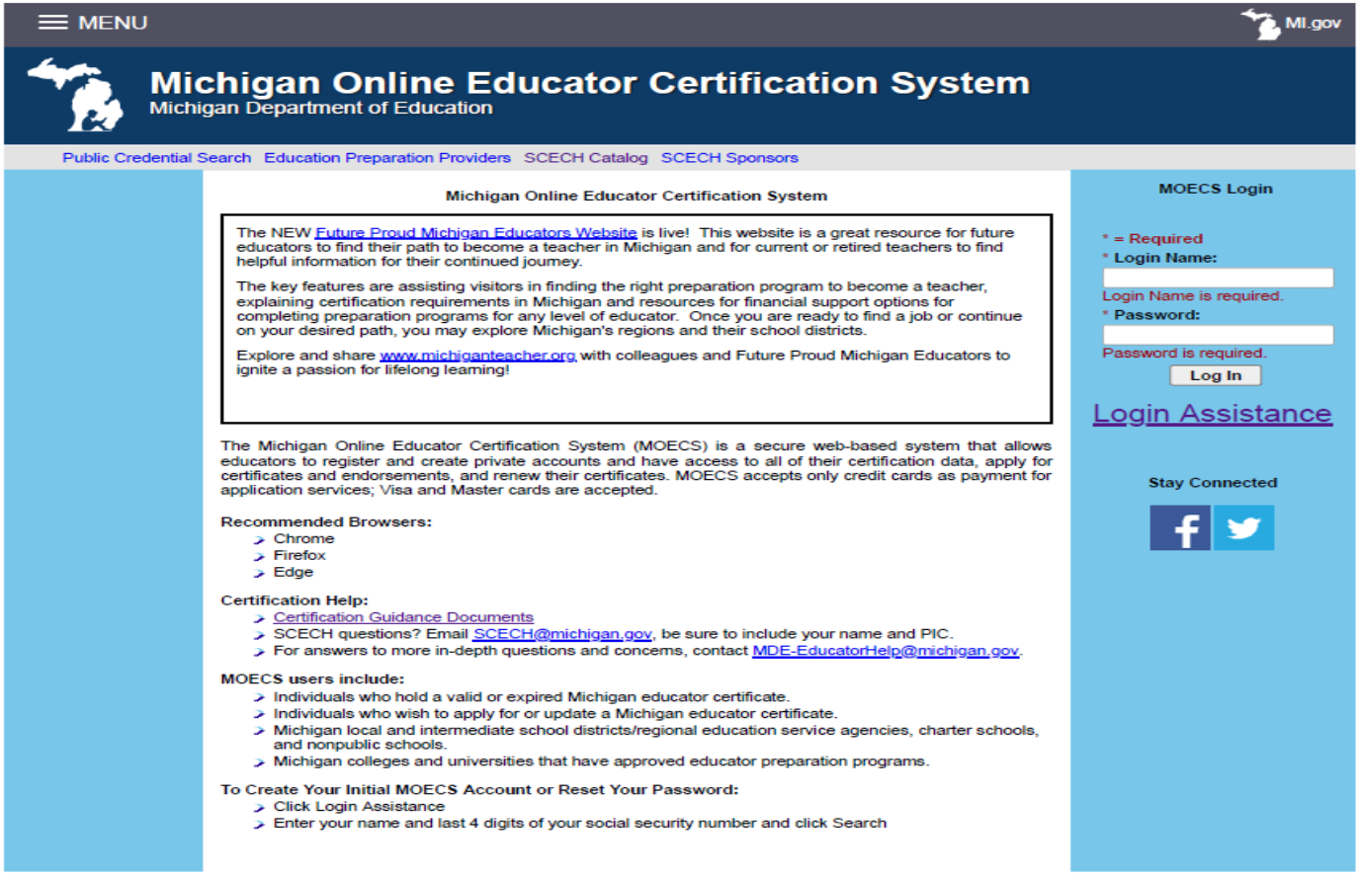
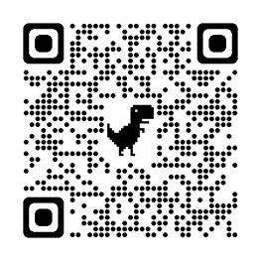
How to apply
Note:
Michigan Education Information System (MEIS)
https://mdoe.state.mi.us/meis/login.aspx
https://mdoe.state.mi.us/moecs/login.aspx
Notes:
How can educators apply for these certificates with the MDE? Educators apply through the Michigan Online Educator Certification System know as MOECS. Log-in page with URL and QR code shown here. If the educator is without a login name or password, the educator will need to set-up a profile via the Michigan Education Information System (MEIS). The URL for the page is also provided.

Slide 13
System Navigation
Notes:
Once the educator is in the system, they should see a page similar to this page where they can navigate to their needs using the left navigation panel.

Slide 14
Changes are coming
  Elementary (K-5) and secondary (6-12)
  Changes to the educator certification grade bands
  The new bands are more specialized
    Comes with new MTTCs
Notes:
Changes are coming:
Currently, we have elementary (K-5) and secondary (6-12) bands.
However, changes to the educator certificate grade bands have begun.
The new bands are more specialized and come with new MTTCs
To my knowledge, current certificates with the (elementary or secondary) grade bands, will remain the same. Existing teacher certificates will not adjust to accommodate the new certification structure. What is the new structure?

Slide 15
New Grade Bands
The new grade bands:
  Birth–Kindergarten
  Prekindergarten to Grade 3
  Grades 3 through 6
  Grades 5 through 9
  Grades 7 through 12
  Prekindergarten (PK)-12
Notes:
The new bands are as follows:
Birth–Kindergarten
Prekindergarten to Grade 3
Grades 3 through 6
Grades 5 through 9
Grades 7 through 12
Prekindergarten (PK)-12

Slide 16
New Grade Bands Continues…
Due to staffing shortages, teachers may teach outside the grade range & content area listed on their certificate, without a permit, as depicted in the chart below.
Notes:
What happens if there are staffing shortages?
Due to staffing shortages, teachers with these new endorsements may teach outside the grade range and content area listed on their certificate, without a permit, as depicted in the chart below.
NOTE: MDE will periodically review and modify this flexible placement policy to address state workforce and student needs.

Slide 17
Notes:
When are or when have these changes taken place?
This chart depicts the Educator Preparation Institution’s timeline to create and implement their programs to address the certification structure changes, when the new MTTC’s will be offered and when the current/old MTTCs will be discontinued.

Slide 18
Additional Information
Updates: New Michigan Certification Structure Video
https://www.youtube.com/watch?v=8VLu7QLz8hE
Notes:
For more detailed information, I encourage everyone to view the New Michigan Certification Structure Video released this past February. It is presented by the Sean Kottke of the MDE
The link to this video is provided on this slide. It is about 16 minutes long.

Slide 19

Alternate Routes to Teacher Certification
Interim Teaching Certificate (ITC)
Notes:
Sometime ago, the MDE developed policy to allow Alternate Routes to Teacher Certification
These are non-traditional preparation programs designed for individuals who hold a minimum of a bachelor’s degree and are seeking to complete an expedited teacher preparation program while employed as a teacher under an Interim Teaching Certificate (ITC).

Slide 20
To be eligible candidates must…
  Bachelor’s degree
  Grade point average of 3.0 (cohort)
  MTTC
  CPR/First Aid
  Criminal Background Check
Notes:
The requirements to be eligible for the ITC are as follows:
Hold a minimum of a bachelor’s degree
Be in a cohort grade point average of 3.0 on 4.0 scale
Pass the appropriate endorsement area Michigan Test(s) for Teacher Certification (MTTC)
Have current CPR/First Aid certification
Go through a Criminal Background Check

Slide 21
Interim Teaching Certificate (ITC) Facts
5 years
Continued enrollment
ITC standard certificate
Notes:
Here is what you need to know about the ITC.
1. It is valid for 5 years
2. The teacher must continue to be enrolled in the alternative route preparation program
3. The teacher can progress from the ITC to the standard certificate

Slide 22
Progressing from the ITC to a Standard Teaching Certificate
Alternative route program completion
Three years of successful teaching
MOECS application
Recommendation by the alternative route provider
Notes:
How to progress from the ITC to the Standard Teaching Certificate?
1. Successful completion of alternative route program
2. Taught successfully for three years, within the validity of their endorsement areas (a minimum of 12 weeks per endorsement area)
3. Submit an application for certification within the Michigan Online Educator Certification System (MOECS)
4. Recommendation by the alternative route provider.

Slide 23
Wayne State University Offers an Alternative Route
  Warrior Teacher Program
  Certification areas:
    Elementary Education (K-5 all subjects; K-8 self-contained)
    Specific subject area in secondary education (grades 6-12)
    Health and Physical Education (grades K-12)
    Visual Arts (grades K-12)
  1-year program
  Select partner school
  MTTC
  Earned bachelor’s
Notes:
As a friendly reminder, Wayne State University now offers an Alternative route program called the Warrior Teacher Program.

Slide 24
Contact Information
WSU Contact:
            Dr. Deborah A. Gibson
(313) 577-1601
cc5809@wayne.edu
MDE Contact Information:
            Sean Kottke
            KottkeS@Michigan.gov
            Gina Garner
            GarnerG1@Michigan.gov

Slide 25

Questions?

