Slide 1
Interrupting Prolonged sitting with ACTivity
Rebecca Hasson, PhD, FACSM
University of Michigan

Slide 2
Unintended consequences of the COVID-19 pandemic on children
Physical Inactivity and Screen Time
Rapid Weight Gain
Achievement Gap and Digital Divide
Depression and Anxiety
Orphanhood and Caregiver Death
Nagata et al., JAMA Pediatr. 2021
Woolford et al., JAMA 2021; 326(14):1434-1436
U.S. Department of Education, 2021
Racine et al., JAMA Pediatr. 2021;175(11):1142-1150
Hillis et al., Pediatrics. 2021; e2021053760
Notes:
Physical activity declined and screen time doubled among children and adolescents
Overweight or obesity increased among 5- through 11-year-olds from 36.2% to 45.7% during the pandemic, an absolute increase of 8.7% and relative increase of 23.8% compared with the reference period.
According to one nationally representative survey from May 2020, only 15% of districts expected their elementary students to be receiving instruction for more than four hours per day during remote learning, while 85% of districts expected instructional time to dip under four hours—more than an hour per day less than the pre-pandemic national average of five instructional hours per day. Even further, according to the same report, in nearly a fifth of districts surveyed (17%), the instruction students did receive in spring 2020 was designed not to teach new skills and understanding, but to review what had already been taught—in a sort of pandemic holding pattern.
1 in 4 youth globally are experiencing clinically elevated depression symptoms, while 1 in 5 youth are experiencing clinically elevated anxiety symptoms
At least 150,000 American children have lost a parent or caregiver because of covid- meaning that one of roughly every 500 children lost one of the most important adults in their life.

Slide 3
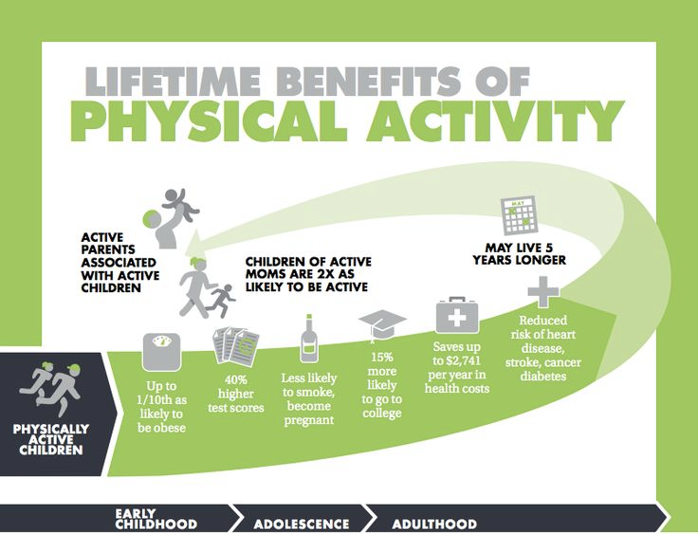
Intellectual Capital
School engagement
Concentration/Attention
Memory
Academic performance
Social Capital
Positive relationships
Social inclusion & acceptance
Teamwork/Collaboration
Community cohesion
Bridging differences
Emotional Capital
Feeling good
Self esteem
Mood
Lowers stress, anxiety & depression
R. Bailey et al. (2012) Physical activity as an investment in personal and social change: The Human Capital Model. Journal of Physical Activity and Health, 9:1053-1055; Designedtomove.org

Slide 4
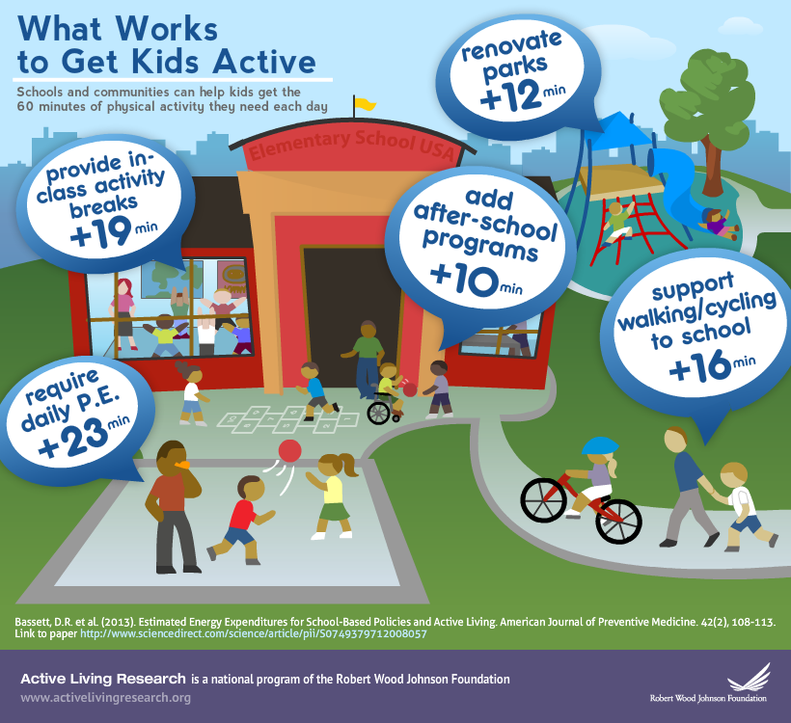
D.R. Bassett et al. (2013) Estimated energy expenditures for school-based policies and active living. American Journal of Preventive Medicine, 44(2): 108-113.
Notes:
We want to give you tools and resources to support classroom teachers and parents promote physical activity!

Slide 5
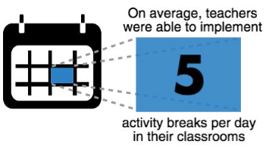
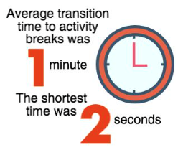
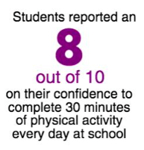
InPACT by the numbers
LR Beemer et al. (2018) Feasibility of the InPACT intervention to enhance movement and learning in the classroom. Translational Journal of the American College Sports Medicine, 3(18):136-151.

Slide 6
Popular classroom activity resources
43%
The percentage of elementary schools across the country that have students participating in physical activity breaks during the school day.
Notes:
What are other programs/resources that teachers are using?
While teachers are implementing PA breaks, they are not doing it consistently or with fidelity
include stat on how many elementary school teachers are currently implementing pa breaks-- only 43% of elementary schools have students participate in physical activity breaks during the school day

Slide 7
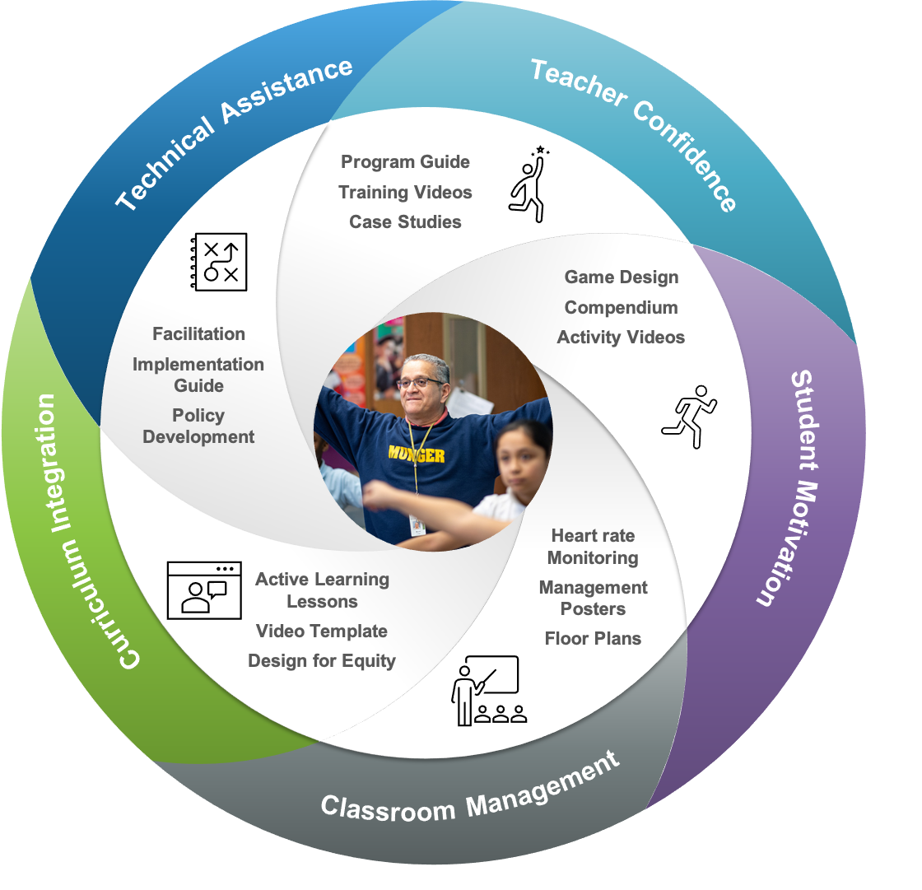
InPACT coaching model
www.inpact.kines.umich.edu
RE Hasson et al. (2021) Adapting the InPACT Intervention to Enhance Implementation Fidelity and Flexibility. Prev Sci., 22(3):324-333.
Notes:
Our coaching model is simple. We recognize that classroom teachers will need to master three important skills in order to successfully implement classroom activity breaks: classroom management, curricular integration, and student motivation. We also recognize that teachers will need support and services in order to overcome the daily challenges of mastering these skills.
​
In response to these challenges, we offer a series of guiding principles and strategies that provide classroom teachers with the necessary training, skills, and support to tailor and deliver 20 minutes of physical activity in their classroom every day. These strategies are based on research conducted in the Childhood Disparities Research Laboratory and in elementary schools across the state of Michigan.

Slide 8
Resources
Program website:
Training videos:
www.inpact.kines.umich.edu
RE Hasson et al. (2021) Adapting the InPACT Intervention to Enhance Implementation Fidelity and Flexibility. Prev Sci., 22(3):324-333.

Slide 9
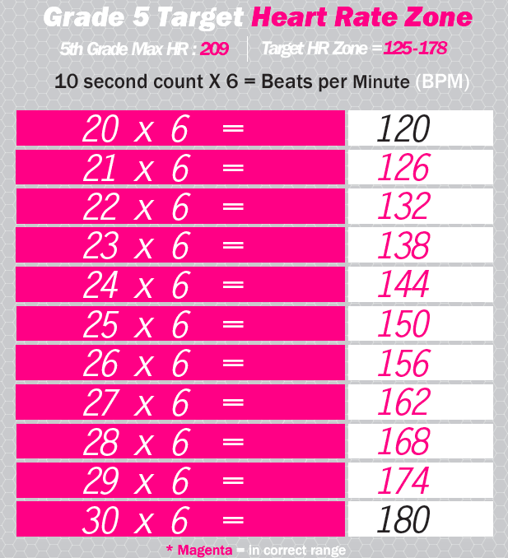
Classroom management
LR Beemer et al. (2018) Feasibility of the InPACT intervention to enhance movement and learning in the classroom. Translational Journal of the American College Sports Medicine, 3(18):136-151.
Notes:
Add classroom management video here.

Slide 10
Classroom floorplans
How can teachers redesign their classrooms to promote learning and moving?
US Vance, R.E. Hasson, et al. Move Detroit: An Active Class Space Intervention.
105th ACSA Annual Meeting and Technology Conference Proceedings, 2017.
Notes:
36-48 inches

Slide 11
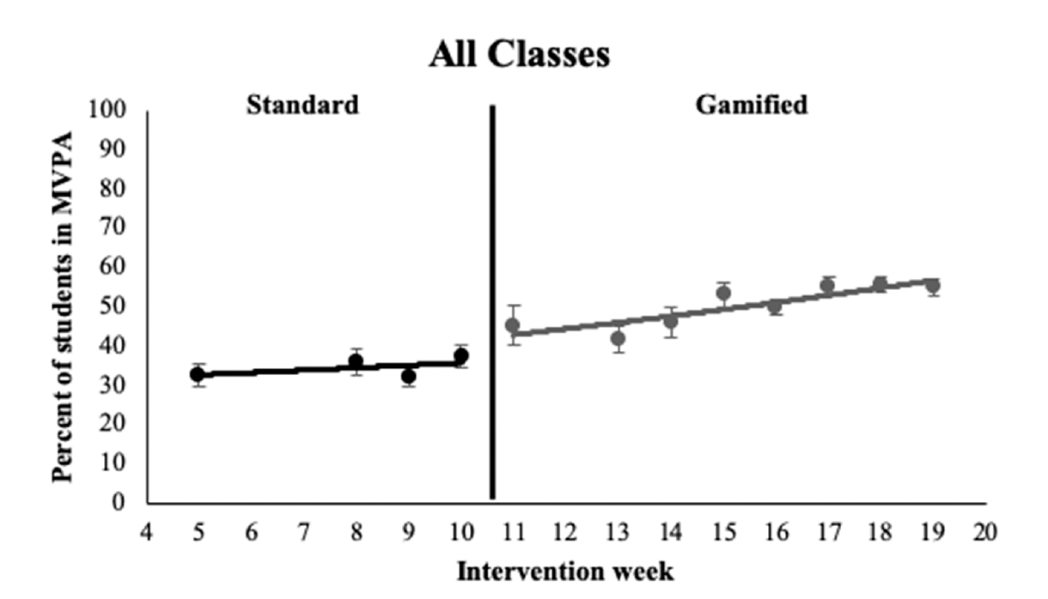
Student motivation
Gamification
The application of game design elements (e.g., point scoring and competition) and game principles in non-game contexts.
27% increase in students participating at a moderate-to-vigorous intensity
LR Beemer, et al. (2019) A Pilot Intervention Using Gamification to Enhance Student Participation in Classroom Activity Breaks. Int J Environ Res Public Health. 24;16(21):4082.

Slide 12
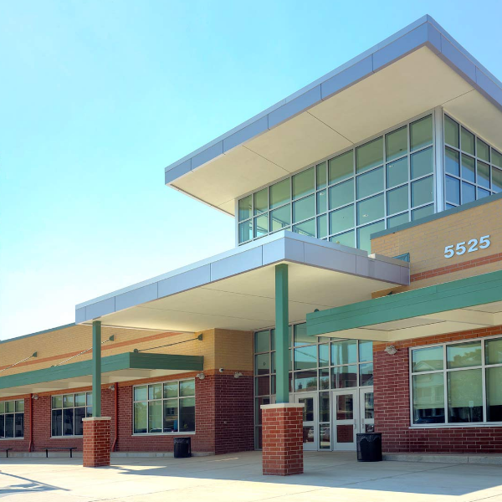
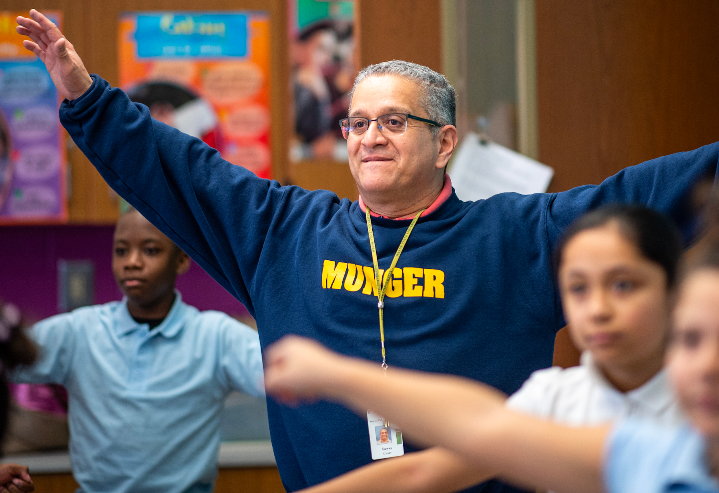
InPACT coaching model increased program fidelity!
Low-Income School
1000 Students
92% non-white
80% qualified for free/reduced lunch
7 statewide percentile ranking
High leadership support
3rd to 5th grade students accumulated an additional 21 minutes of physical activity in the classroom per day!
LR Beemer et al. (2019) A Pilot Intervention Using Gamification to Enhance Student Participation in Classroom Activity Breaks. Int J Environ Res Public Health, 16(21):4082.; RE Hasson et al. (2021) Adapting the InPACT Intervention to Enhance Implementation Fidelity and Flexibility. Prev Sci., 22(3):324-333.
Notes:
Tested in 3 elementary schools across Southeast Michigan
”they ranked higher than 86% of schools ranked statewide based on the Michigan school data 2015-2016 accountability results
Three elementary schools (20 teachers, 500 students) in SouthEast Michigan agreed to participate in this pilot study. There were a total of 20 teachers and 500 students participating ranging from grades 3-6. These three schools were selected based on their diversity in socioeconomic status and student demographics.

Slide 13
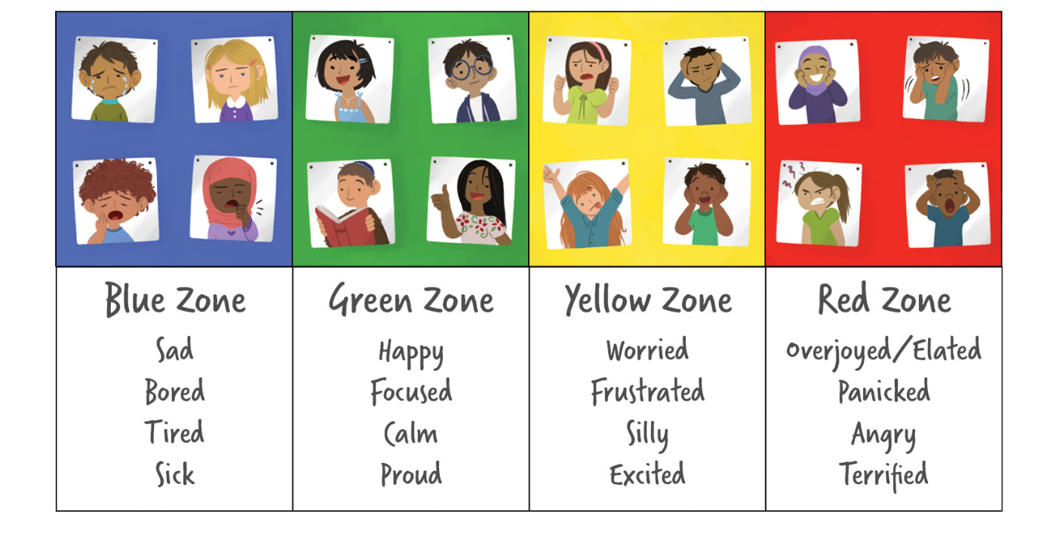
Zones of Regulation
A curriculum designed to foster self-regulation and emotional control
Created by Leah Kuypers

Slide 14
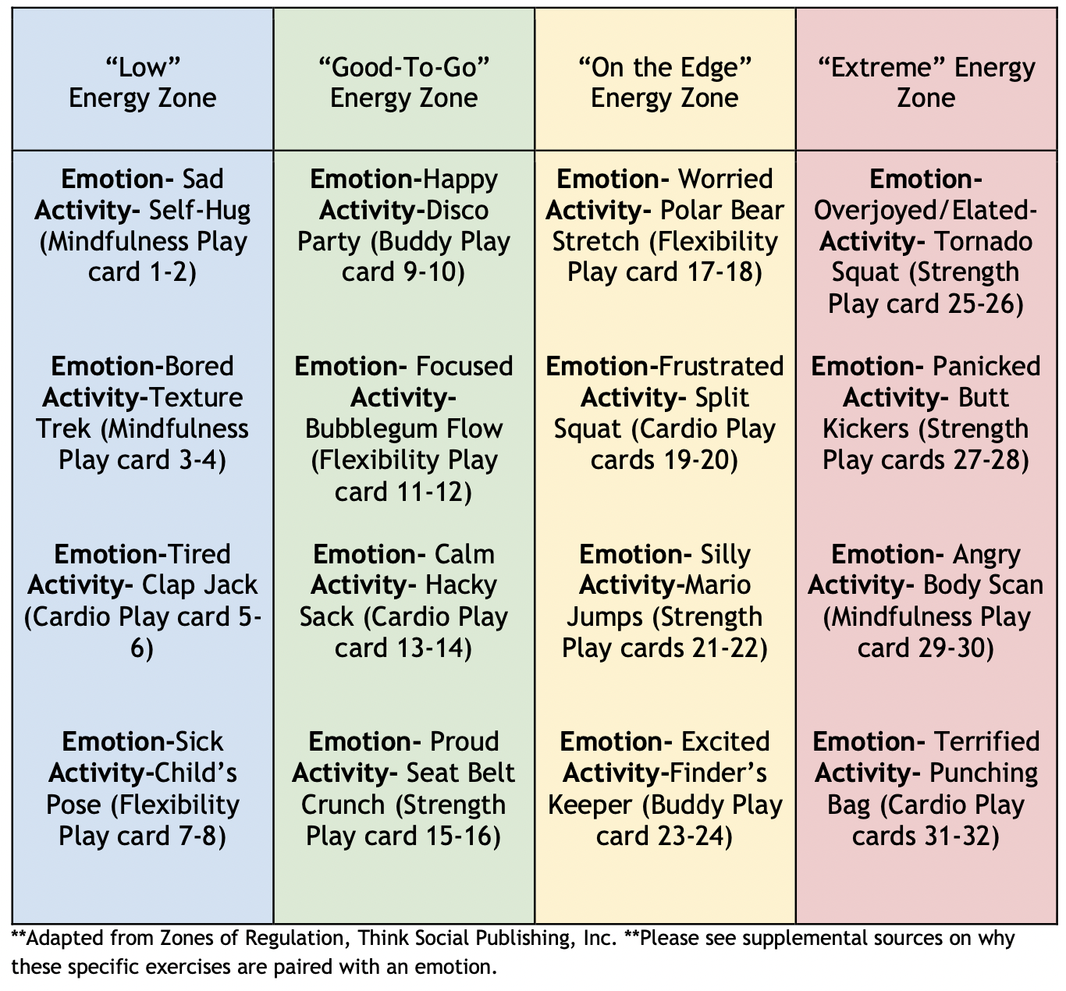
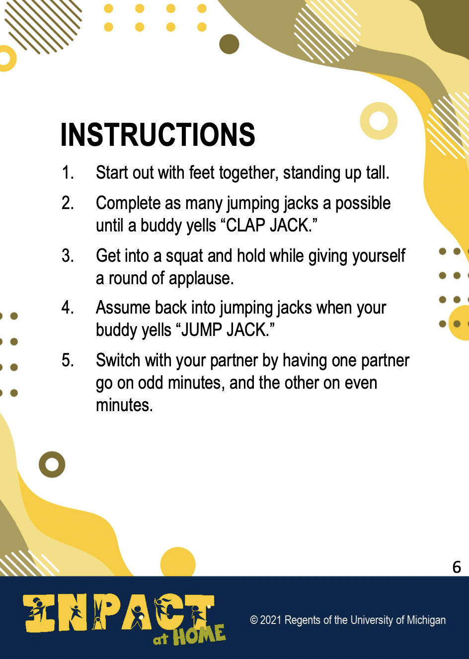
Connection physical activity to emotions

Slide 15
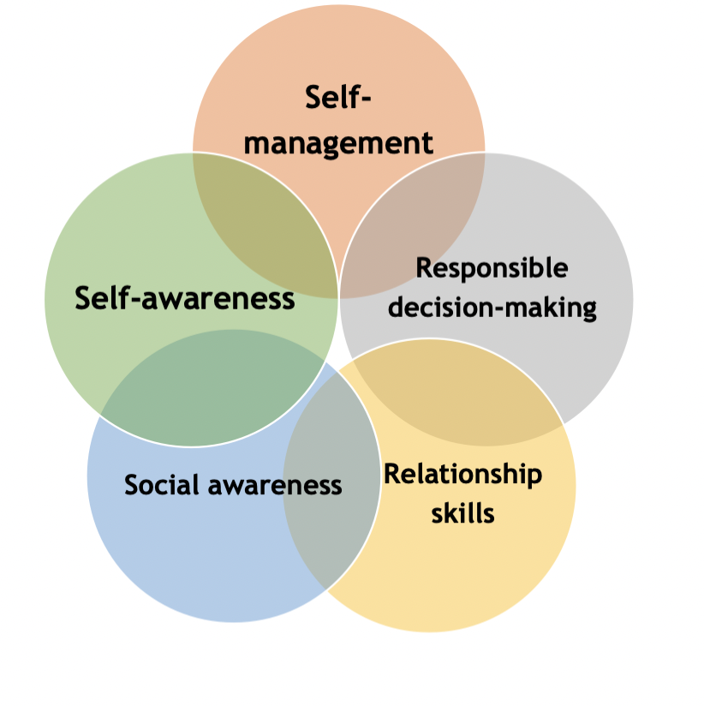
Building resilience over time
Hypothesis: as students continue to engage in these activities over time, these social-emotional skills will develop thereby enhancing resilience.
Core competences of the CASEL Framework www.casel.org

Slide 16
Policies, Systems, and Environmental Approach

Slide 17
Step-by-Step process for systems change
GA Aarons (2011). Advancing a conceptual model of evidence-based practice implementation in public service sectors. Administration and Policy in Mental Health and Mental Health Services Research, 38(1), 4-23

Slide 18
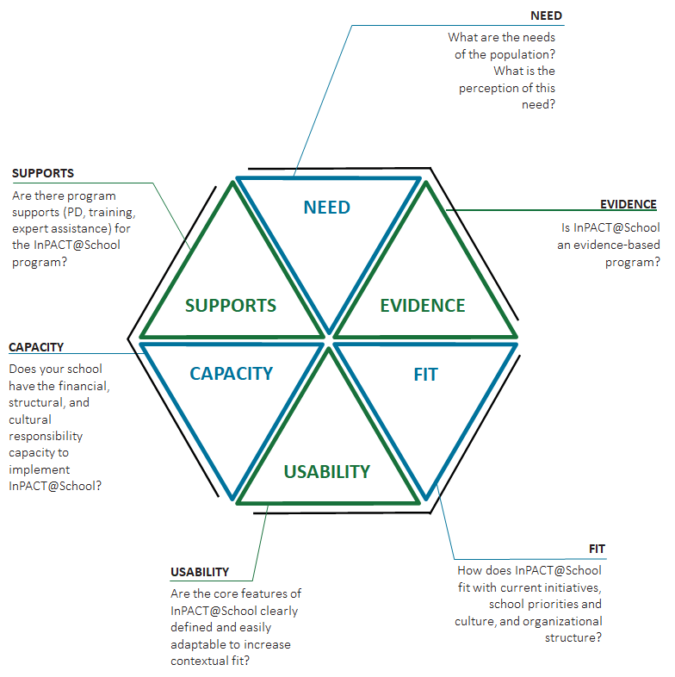
Exploration- intervention/ context fit
March 2020
Score: 19/30
March 2021
Score: 28/30
Metz, A. & Louison, L. (2018) The Hexagon Tool: Exploring Context. Chapel Hill

Slide 19
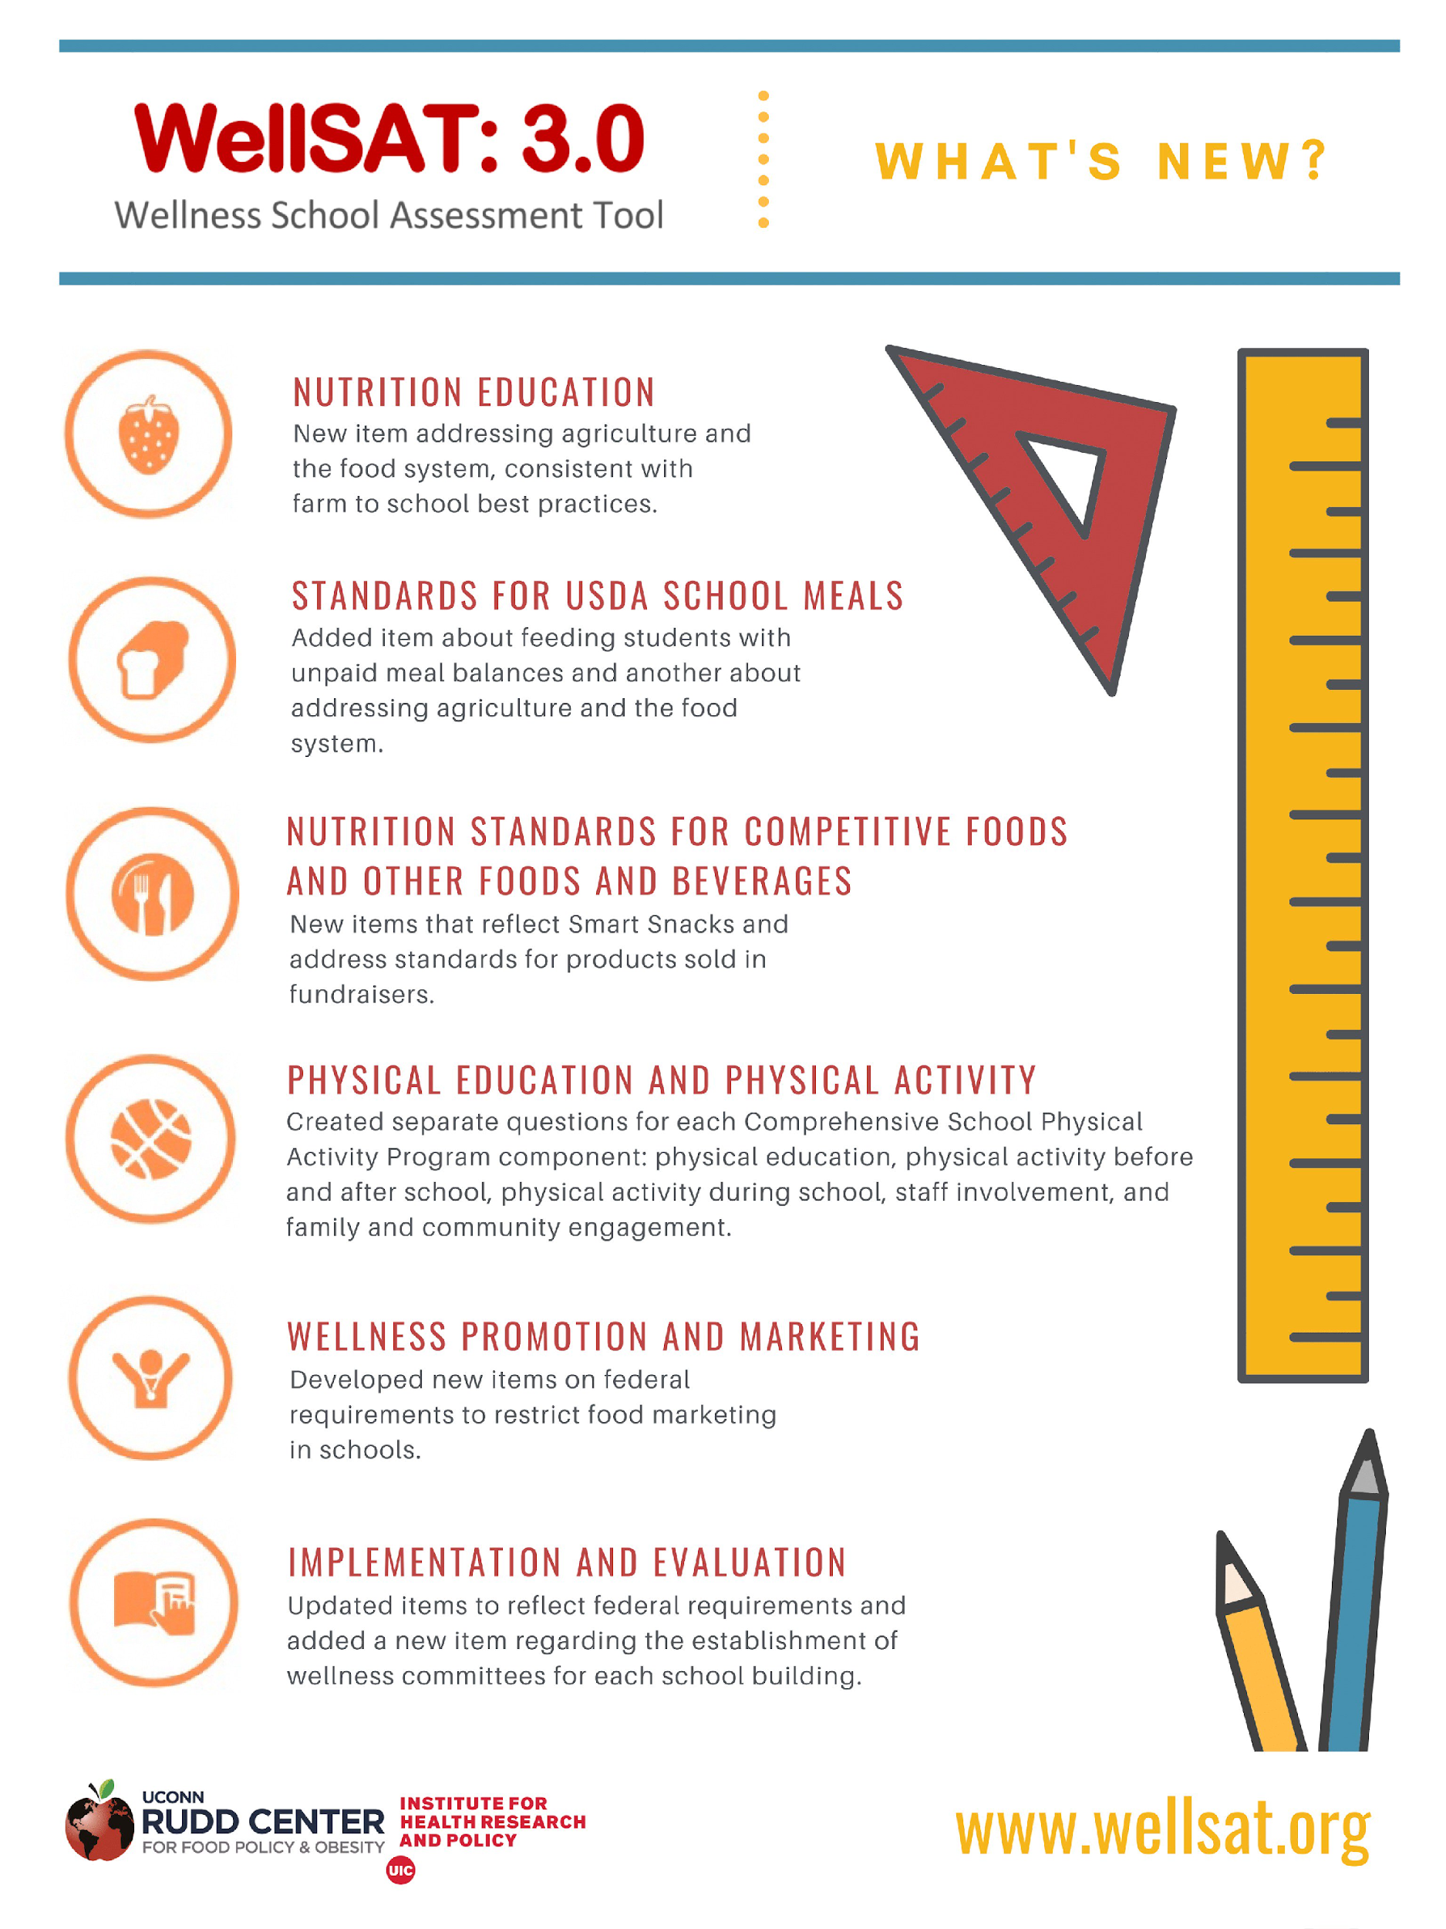
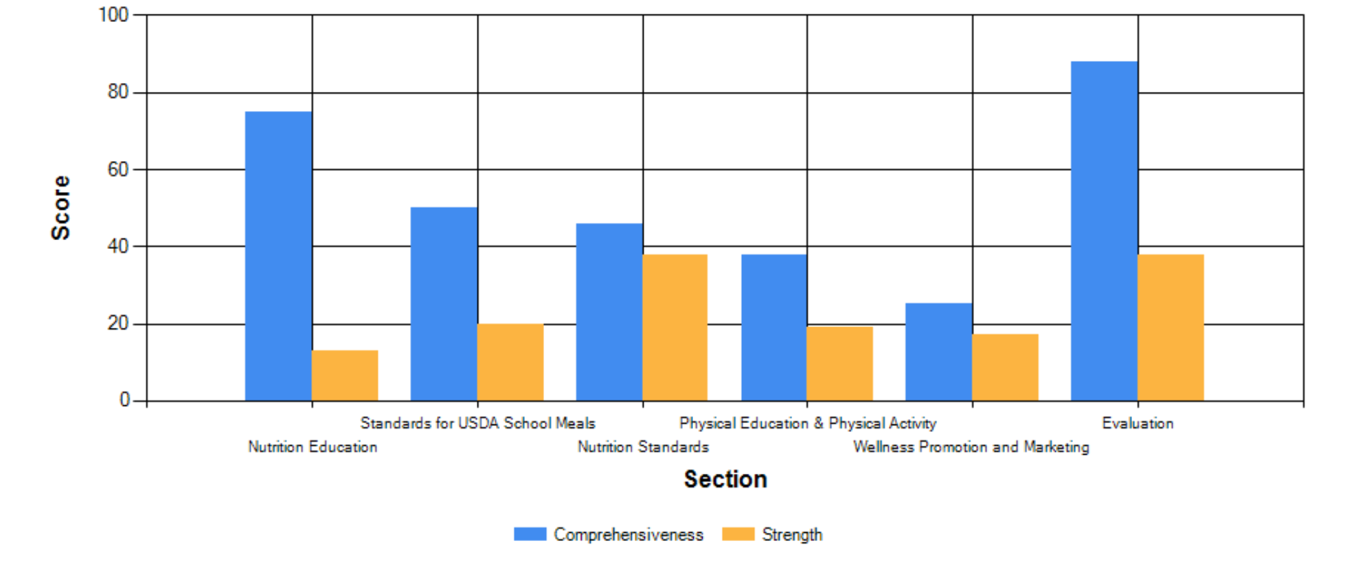
Exploration- policy evaluation

Slide 20
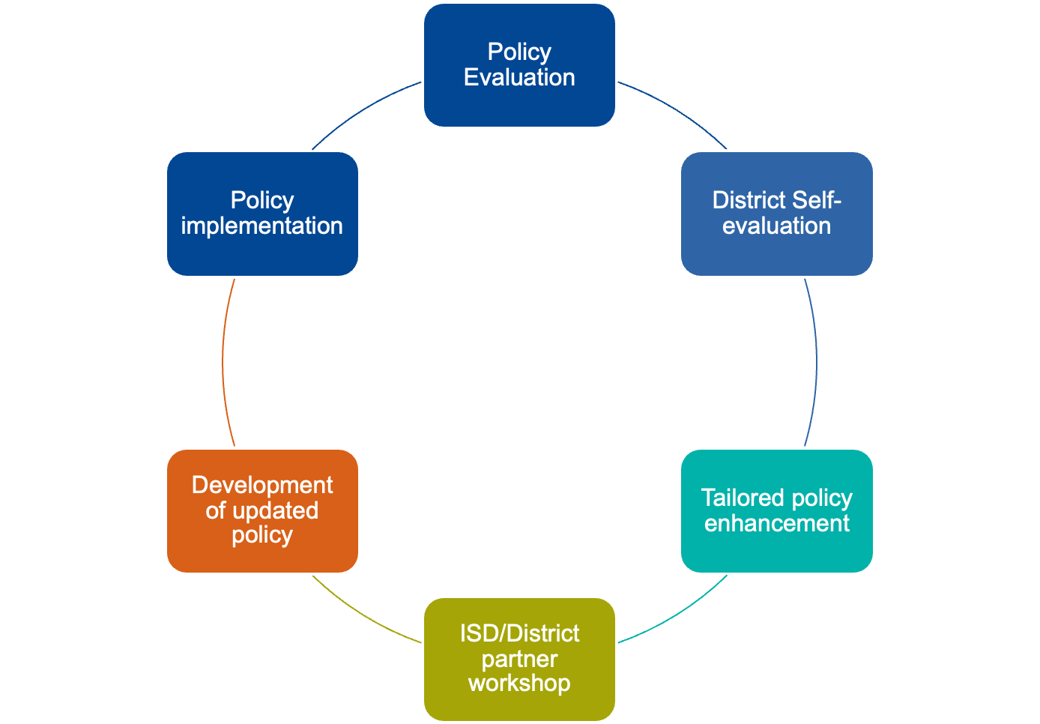
Policy Enhancement Process
How will we monitor policy implementation?
What does your policy language say?
What is the process to implement the new policy?
What are you actually doing?
Student Wellness
Is the new policy feasible for all?
Are the policies and programs aligned?
Is the new policy feasible?

Slide 21
Tiered approach to policy enhancement
BRONZE
Districts shall provide training to all elementary school teachers for classroom activity
Elementary schools shall provide 5-10 minutes of classroom activity each day to provide all students with physical activity opportunities
SILVER
Districts shall provide training to all elementary school teachers for classroom activity
Elementary schools shall provide 10-15 minutes of classroom activity each day to provide all students with physical activity opportunities
GOLD
Districts shall provide training to all elementary school teachers for classroom activity
Elementary schools shall provide 20 minutes of classroom activity each day to provide all students with physical activity opportunities
InPACT Tiered Approach to Classroom Activity Policy Enhancement

Slide 22
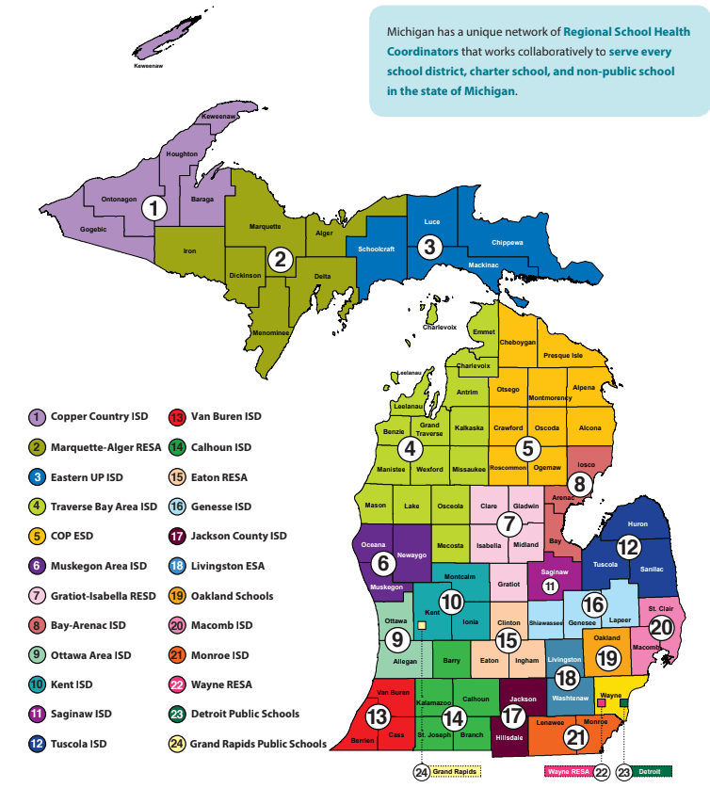
Preparation- TOT programming
Saginaw ISD Regional School Health Coordinator
University of Michigan
School District 1
School District 2
School District 3
School 1
School 1
School 1
School 2
School 2
School 2
School 3
School 3
School 3
Used with permission from the Michigan School Health Coordinators’ Association: Mishca.org

Slide 23
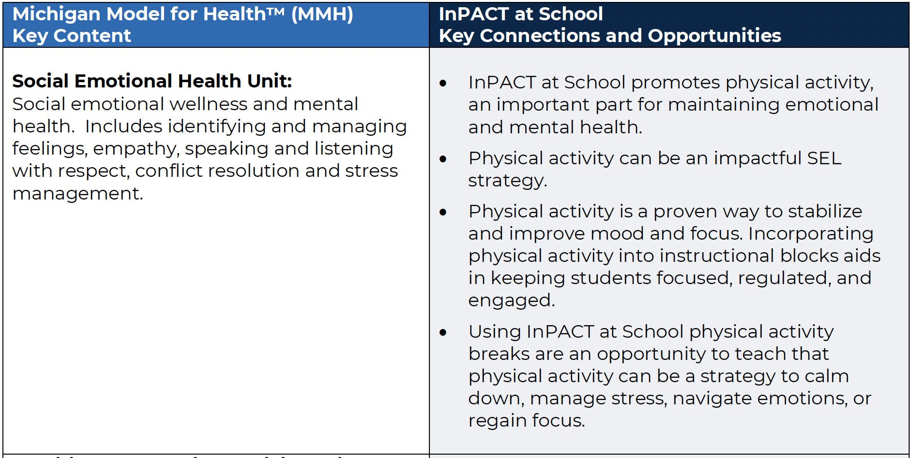
Alignment with state health curriculum

Slide 24
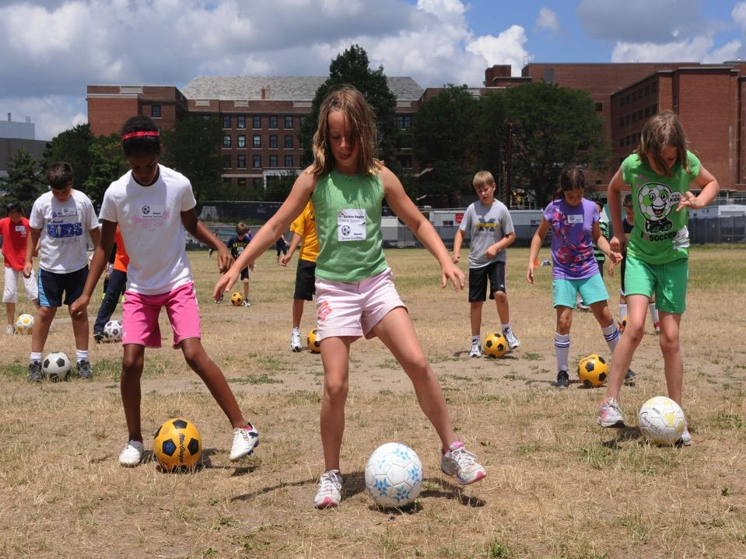
Challenges
BEFORE COVID
School budgets
Limited recess
Smartphones/screen time
Classroom behaviors
Unsafe neighborhoods
Lack of equipment to exercise safely
DURING COVID
Substitute teacher shortage
PE canceled/altered
Increased screen time
Students remain in classroom
Fear of going places/isolation
Sports/exercise classes were canceled
Trauma/stress
Notes:
School Budgets: We saw an increase in insurance rates, consumer products, etc yet school funding has remained fairly stagnant. Specials programming in the schools are usually the first to go when budgets are tight. This includes elementary PE.
Limited Recess (General): Michigan winters, inclement weather, not enough equipment for number of students on playground
Limited Recess (Academic/Behavioral): Students miss recess as a form of punishment for “behaviors” or need to get “caught up” on academic learning.
Screen time/Smartphones: More sedentary lifestyles result in an increase in obesity rates and chronic disease issues like Type I Diabetes in youth.
Classroom Behaviors: Trauma Trainings… Approximately 80% of elementary teachers stated that they spend 50-75% of their time in the classroom addressing BEHAVIORS. This impacts learning. This was BEFORE COVID!
Unsafe Neighborhoods: No sidewalks; high crime community; no parks/open spaces nearby to play
Lack of equipment:
*******************************************************************************************************************
Sub shortage: No subs means specials teachers fill in. This means NO PE.
PE canceled/altered: During COVID, there was a strong worry about heavy breathing… so many districts stopped offering PE or changed it so students did not get their heart rates up.
Students remain in classroom: No walking to the cafeteria or specials classes. Teachers came to them. Limited activity in classroom.
At home?: Families stayed home. Didn’t go to the park. Didn’t go to the community center.
Trauma: Cortisol in system… best way to release is through physical activity.

Slide 25
Rapid cycle research
Preparation
Identify partner organizations
Problem Exploration
In-depth understanding of the problem
Knowledge Exploration
Exploring the problem from different perspectives
Solution Development
Identify simple solutions
Solution Testing
Develop process to see if solution works
Implementation & Dissemination
Final step- get it out to the public
Preparation
Implementation & Dissemination
Problem Exploration
Solution Testing
Knowledge Exploration
Solution Development
K Johnson, et al. (2015) Using rapid-cycle research to reach goals: awareness, assessment, adaptation, acceleration. AHRQ Publication No. 15-0036. Rockville (MD): Agency for Healthcare Research and Quality.

Slide 26
Preparation
Preparation
Implementation & Dissemination
Problem Exploration
Identify partner organizations and individuals within those organizations who will champion the program
Solution Testing
Knowledge Exploration
Solution Development
Logos used with permission from each organization.
RE Hasson et al. (2021) Rapid cycle adaptation of the InPACT program to promote youth physical activity during the COVID-19 pandemic. Under review at Translational Behavioral Medicine

Slide 27
Problem exploration
Preparation
Implementation & Dissemination
Problem Exploration
Solution Testing
Knowledge Exploration
Understanding problems that are important to solve
Engaged partners individually and in a group using a dialogic approach to communication to discuss PA/PE issues with program partners and PE teachers
Solution Development
Conducted a literature review to gain a better understanding of the impact of COVID-19 on physical activity, equity, and health disparities with experts in the field through the American College of Sport Medicine
RE Hasson et al. (2021) Rapid cycle adaptation of the InPACT program to promote youth physical activity during the COVID-19 pandemic. Under review at Translational Behavioral Medicine

Slide 28
Knowledge exploration
Preparation
Implementation & Dissemination
Problem Exploration
Explore the problem from different perspectives
Characterize the problem
Identify other industries that face the same problem
Identify organizations in those industries that have best addressed the problem
Identify the process/activities that differentiate the best organization from others in how they addressed the problem
Solution Testing
Knowledge Exploration
Solution Development
RE Hasson et al. (2021) Rapid cycle adaptation of the InPACT program to promote youth physical activity during the COVID-19 pandemic. Under review at Translational Behavioral Medicine

Slide 29
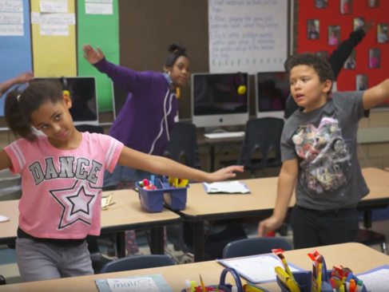
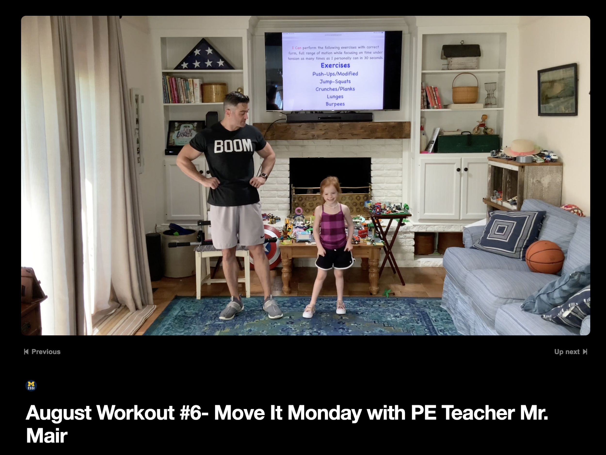
Solution development
Preparation
Implementation & Dissemination
Problem Exploration
Identify the simplest possible solution
Adapt our InPACT at School program for delivery in the home
Solution Testing
Knowledge Exploration
Solution Development
Evidence-based intervention
The InPACTatSchool program provides 20-minutes of health-enhancing physical activity in elementary school classrooms
Core elements retained
Maintenance of intervention dose
Teacher-led physical activities
Use of exercise videos
Key adaptations included
Feature PE teachers in videos
Incorporation of health messaging
Use of media to reach K-12 students across the state
RE Hasson et al. (2021) Rapid cycle adaptation of the InPACT program to promote youth physical activity during the COVID-19 pandemic. Under review at Translational Behavioral Medicine

Slide 30
Solution testing
Preparation
Implementation & Dissemination
Problem Exploration
Process for determining if the identified solution works
RE-AIM framework (reach, efficacy, adoption, implementation, maintenance)
Determined that reach was the most important outcome at this time
Program launch: July 6, 2020
Reach by November 2020- website pageviews 1,400/ video views 1,000
Reach by December 2020- website pageviews 4,777/ video views 1,233
Reach by January 2020- website pageviews 5,147/ video views 3,409
Videos were views in 48 states, 2 US territories and 27 countries around the world (data from Google analytics)
Solution Testing
Knowledge Exploration
Solution Development
RE Hasson et al. (2021) Rapid cycle adaptation of the InPACT program to promote youth physical activity during the COVID-19 pandemic. Under review at Translational Behavioral Medicine

Slide 31
Implementation & dissemination
Preparation
Implementation & Dissemination
Problem Exploration
COVID CARES Funding enabled scale up the program:
Hire additional PE teachers to develop videos
Redesign the program website
Develop a family engagement toolkit
Partner with Detroit Public Television to develop videos in studio
Broadcast videos on public television
Every child in the state of Michigan can now have access to these exercise videos irrespective of whether they have cable or internet access!
Solution Testing
Knowledge Exploration
Solution Development
RE Hasson (2021) Rapid cycle adaptation of the InPACT program to promote youth physical activity during the COVID-19 pandemic. Under review at Translational Behavioral Medicine
MDHHS/MPHI Coronovirus Task Force Rapid Relief Initiative (PI: Hasson, Grant number Q-80041), 2020.

Slide 33
Family Engagement Toolkit
Focus
Family Discussions
Feeling Good
Resilience
Team Building
Lifestyle Choices
Nutrition
Physical Activity
Sleep
Social Emotional Health
Behavioral Health
Move Together.
Think Together.
Be Together.
Physical Health
Asthma Control
Blood Pressure
Blood Sugar
Cholesterol

Slide 34
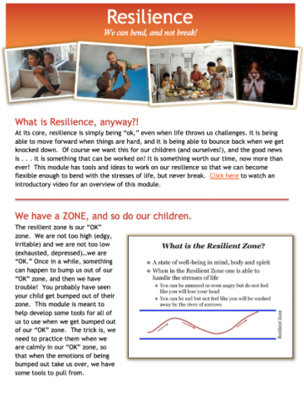
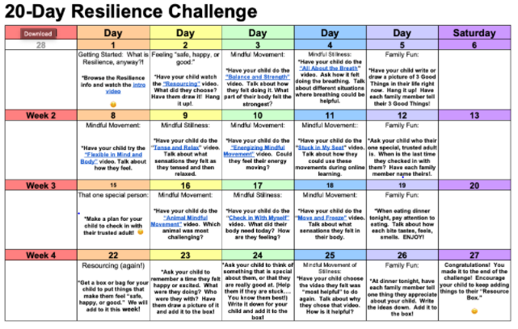
About Family Engagement
Move Together, Think Together, Be Together
9 Modules completed
12 total…final 3 modules coming soon!
Monthly family challenges for each topic
Messaging in modules linked to videos and public TV segments for physical activity

Slide 35
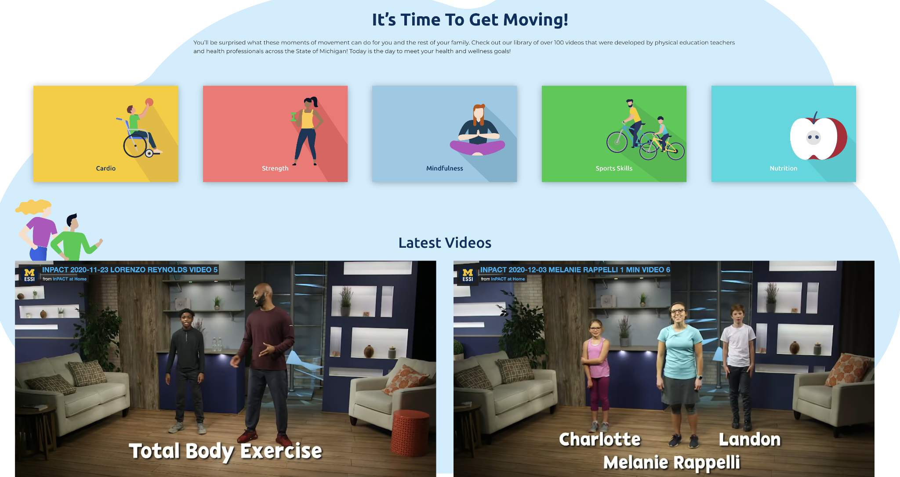
Notes:
450,000 viewers per month

Slide 36
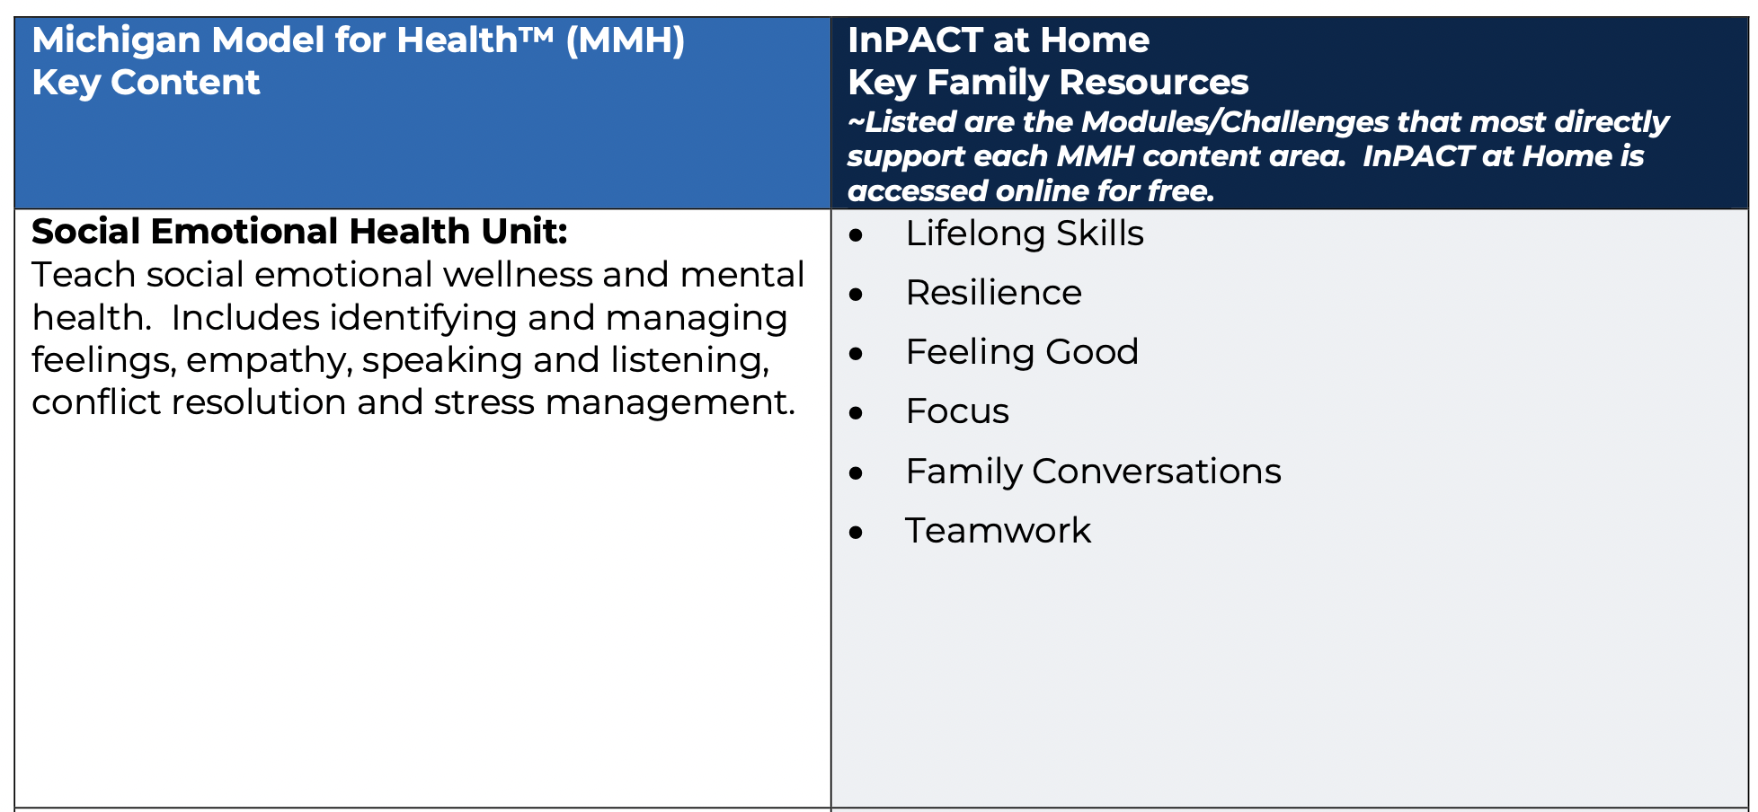
Alignment with state health curriculum

Slide 37
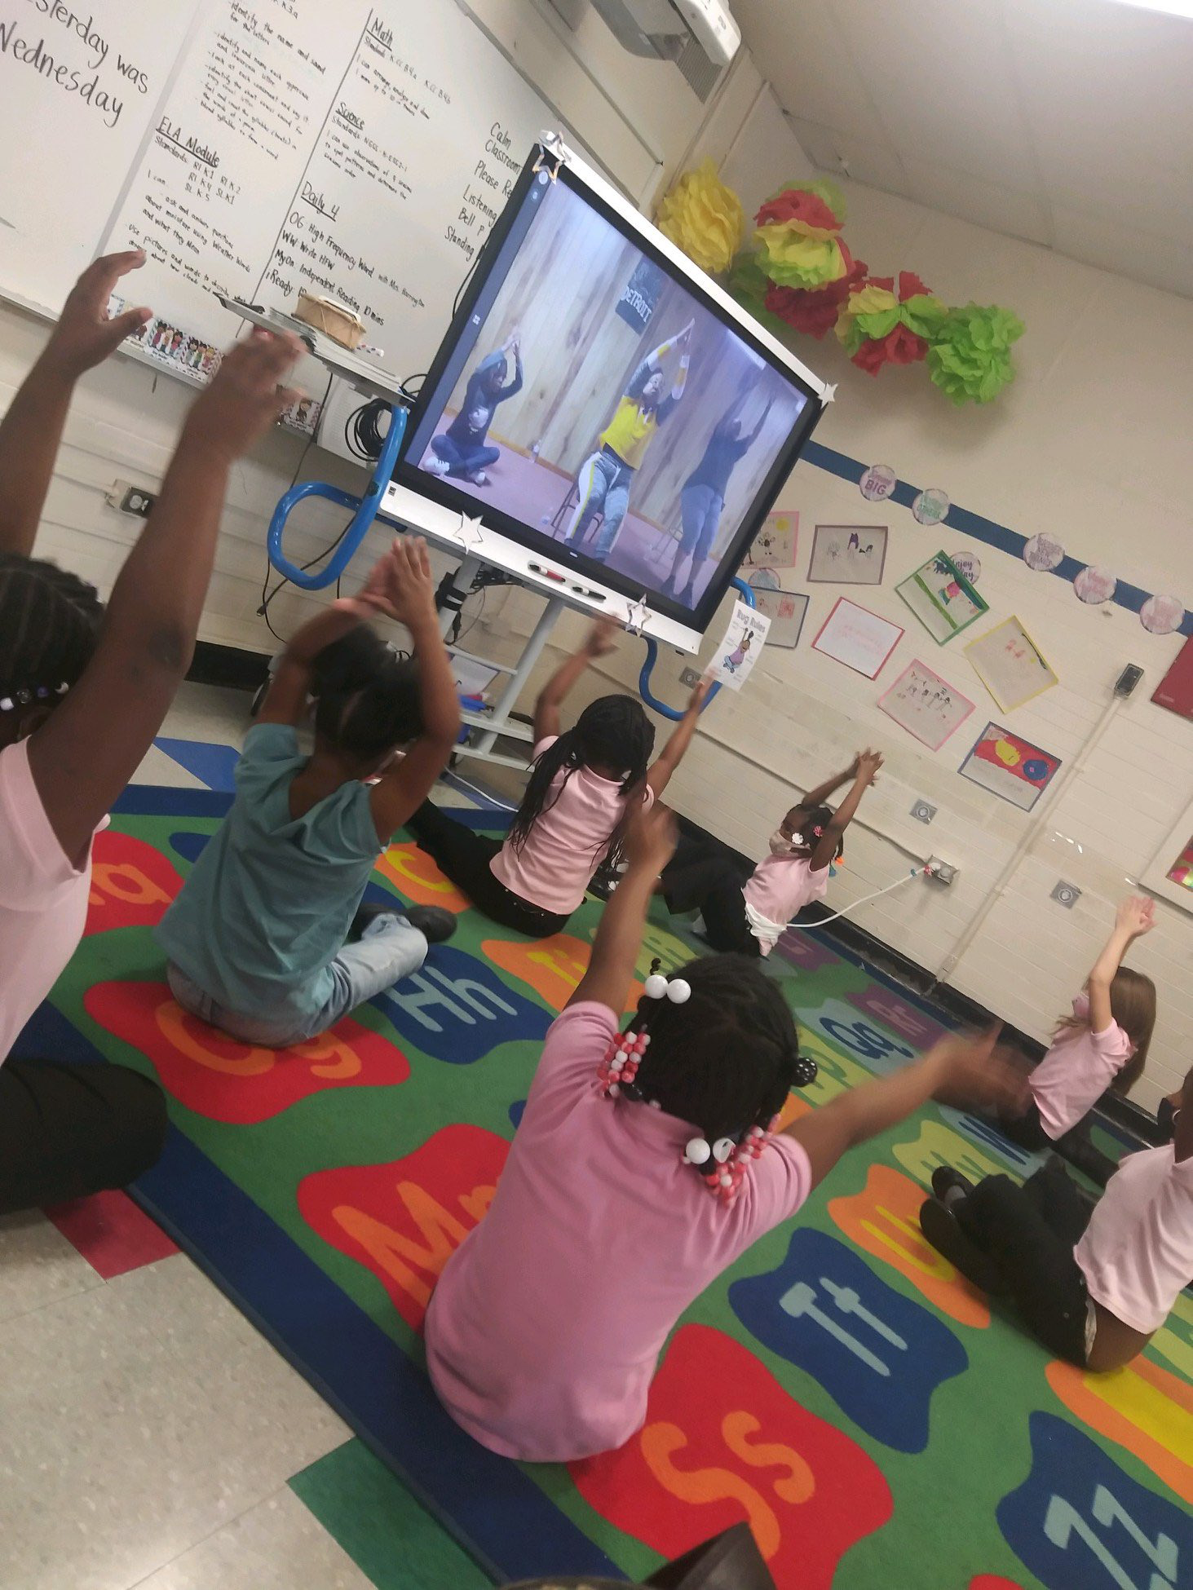
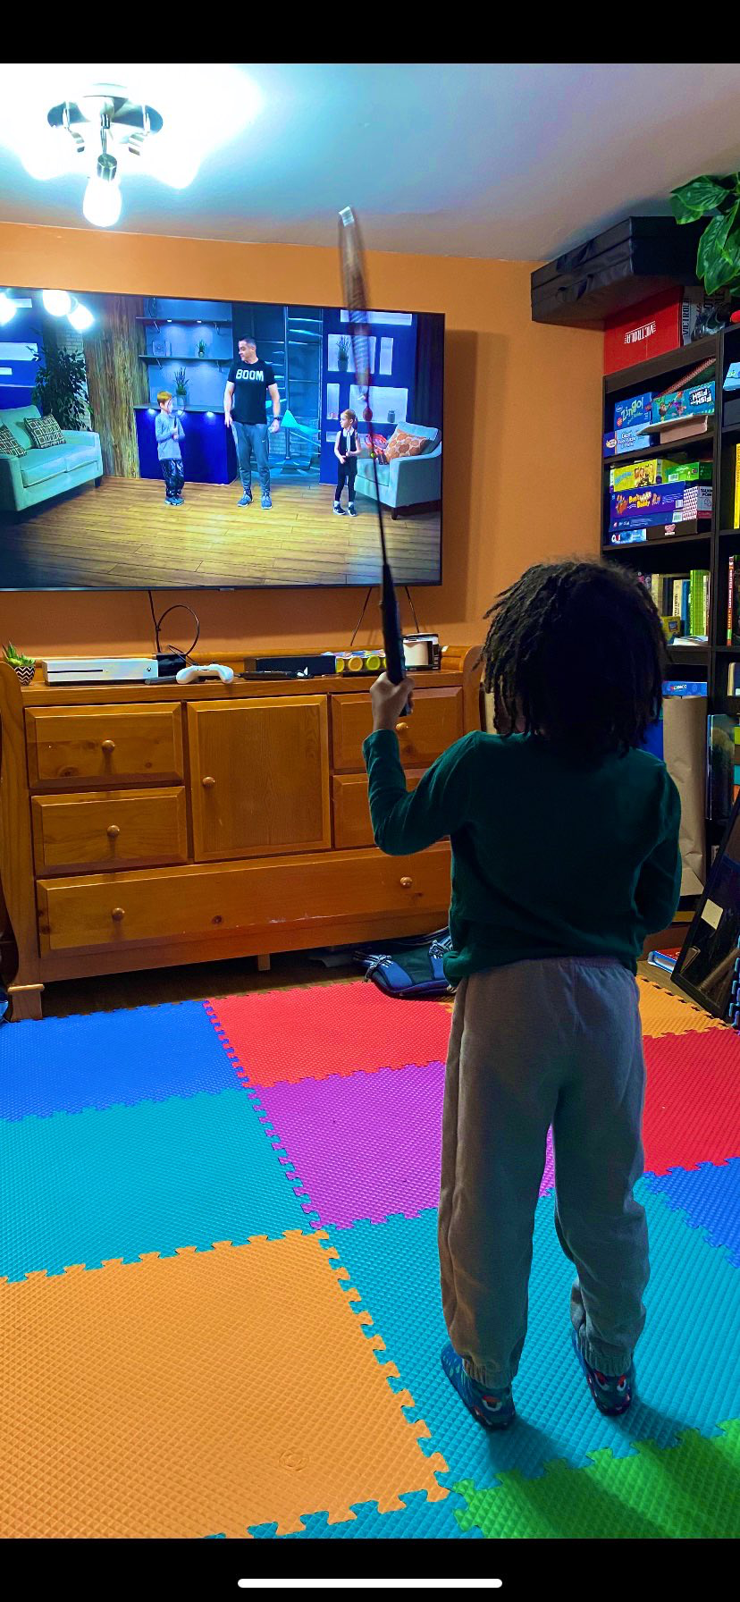
Helping Michigan kids recover from the COVID-19 pandemic
Quote from a Principal
“Kids are amazing I tell you. They have gone through so many disappointments the past two years and I believe that ours will come out with so much resilience because of the work your team is doing. Thank you!”

Slide 38
“The people who are crazy enough to think they can change the world are the ones who do.”
Steve Jobs

