Slide 1
The Elementary Teacher Education Program at OU
August 19th, 2022
Michael MacDonald
Associate Dean
School of Education and Human Services
Oakland University
Email: mmacdona@oakland.edu

Slide 2
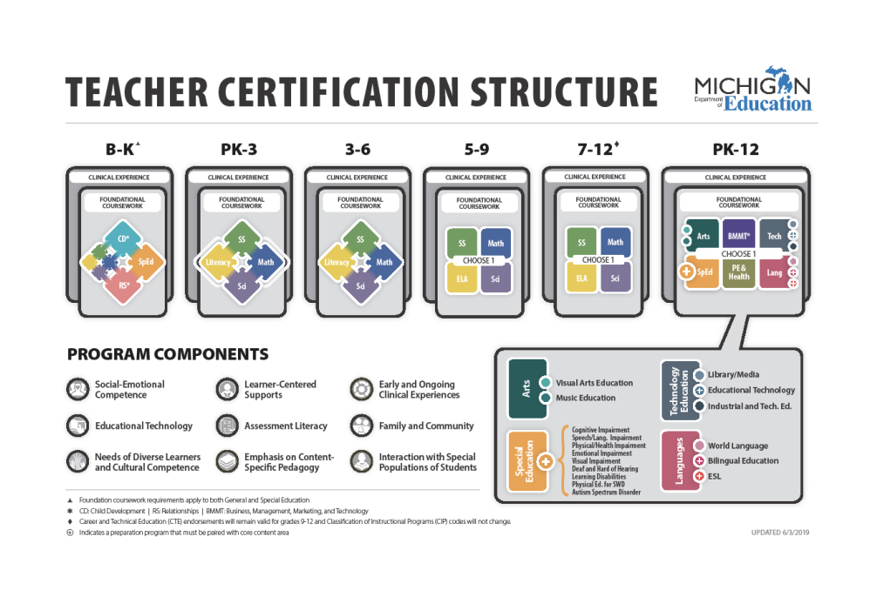

Slide 3
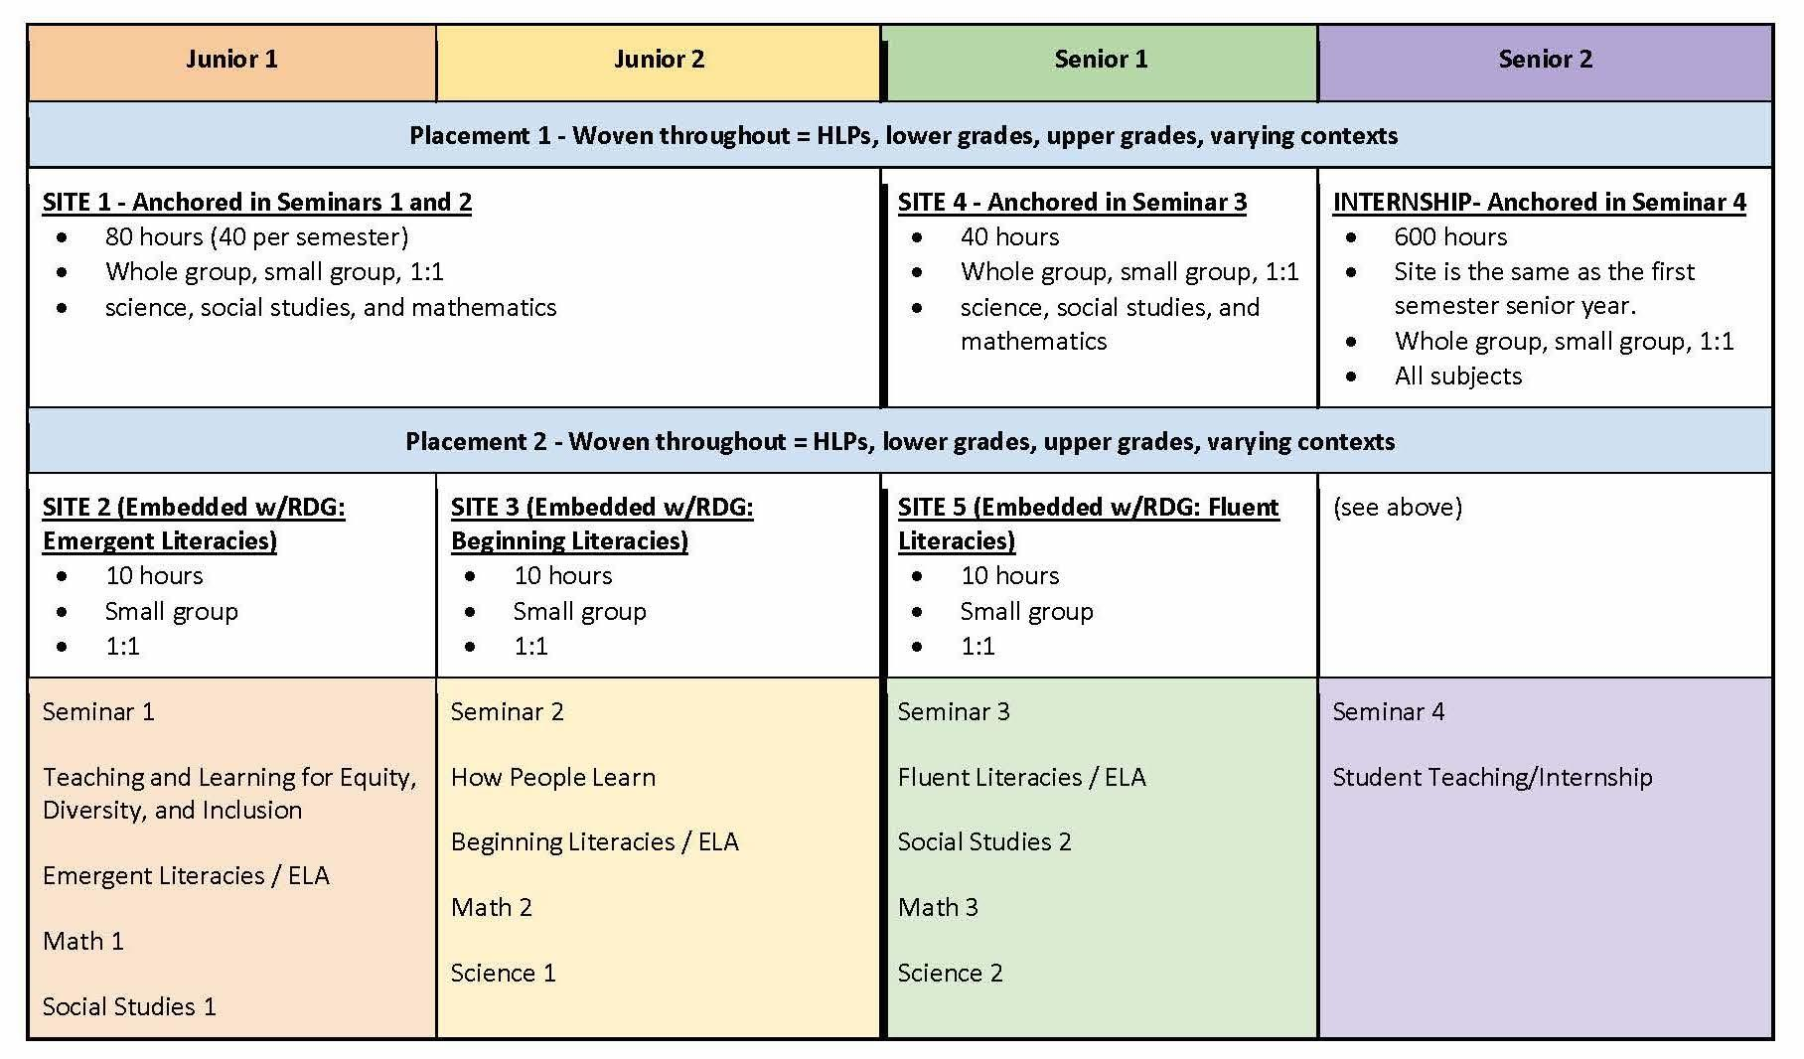
OU Elementary Teacher Education Clinical Program

Slide 4
A Cluster Site Model: Full-Year Clinical Work
Cluster Site Example: School 1
Lower Elementary (K-3)
Upper Elementary (3-6)
1st Grade Mentor
4th Grade Mentor
OU Pair A
Trade places at semester break
OU Pair B
2nd Grade Mentor
5th Grade Mentor
OU Pair C
Trade places at semester break
OU Pair D
~4 hrs per week for one semester (weeks TBD) = 40 hours minimum per semester

Slide 5
Current conversations in OU’s Teacher Development and Education Studies:
Lexicon: shift from supervision, to partnership work. Not university supervising in the field; rather, building a system to support mentor teachers, liaisons, and university faculty as partners. “Supervision” is no longer an effective descriptor because the field assignments are coming from the coursework (e.g. integration of a mathematics teaching practice assignment with a seminar focus); it isn’t about supervising, but supporting/monitoring a student’s learning across university classrooms and field classrooms experiences.
University Faculty and School-based Partners are responsible for monitoring the learning of students across university classrooms and field classrooms experiences.

Slide 6
Clinical Progression
for Learning to Teach
in a Cluster Site
Senior II Internship
Learning to Lead a Professional Practice
Grounded in Michigan Core Practices with a commitment to teaching for social justice.
Oakland University’s Clinical Practices Model for Elementary Education Teacher Preparation
Senior I
Learning to Design and Facilitate Learning
Co-Designing Instruction
Co-teaching with Mentors
Junior II
Interns
Elementary-age students and Experienced Mentor Teacher
Learning to Engage
Working with small groups of learners
Analyzing student work samples
Junior I
Learning to Look
Observation of Mentor Teachers’ Classroom Practices
Working with individuals or small groups of learners
Seminar Students with Major Standing
OU Elementary Education Students in Courses
Notes:
Junior year: full year placement, in pairs with one mentor. Makes more efficient and is good learning buddy structure for students. Maybe producing artifacts of individual work, video samples, etc. Second semester likely move to whole group before reaching senior year.
Senior year: similar to secondary, do a final field experience, stay for student teaching. Seminar instructor still involved. Will choose K-3, or 3-6 to meet state clinical requirements for major certification area. We are building this a semester at a time.
The concentric circles represent the various student roles (Students in courses, Seminar Students with Major Standing, Interns) from peripheral learning to full responsibility in the classroom during internship.

Slide 7
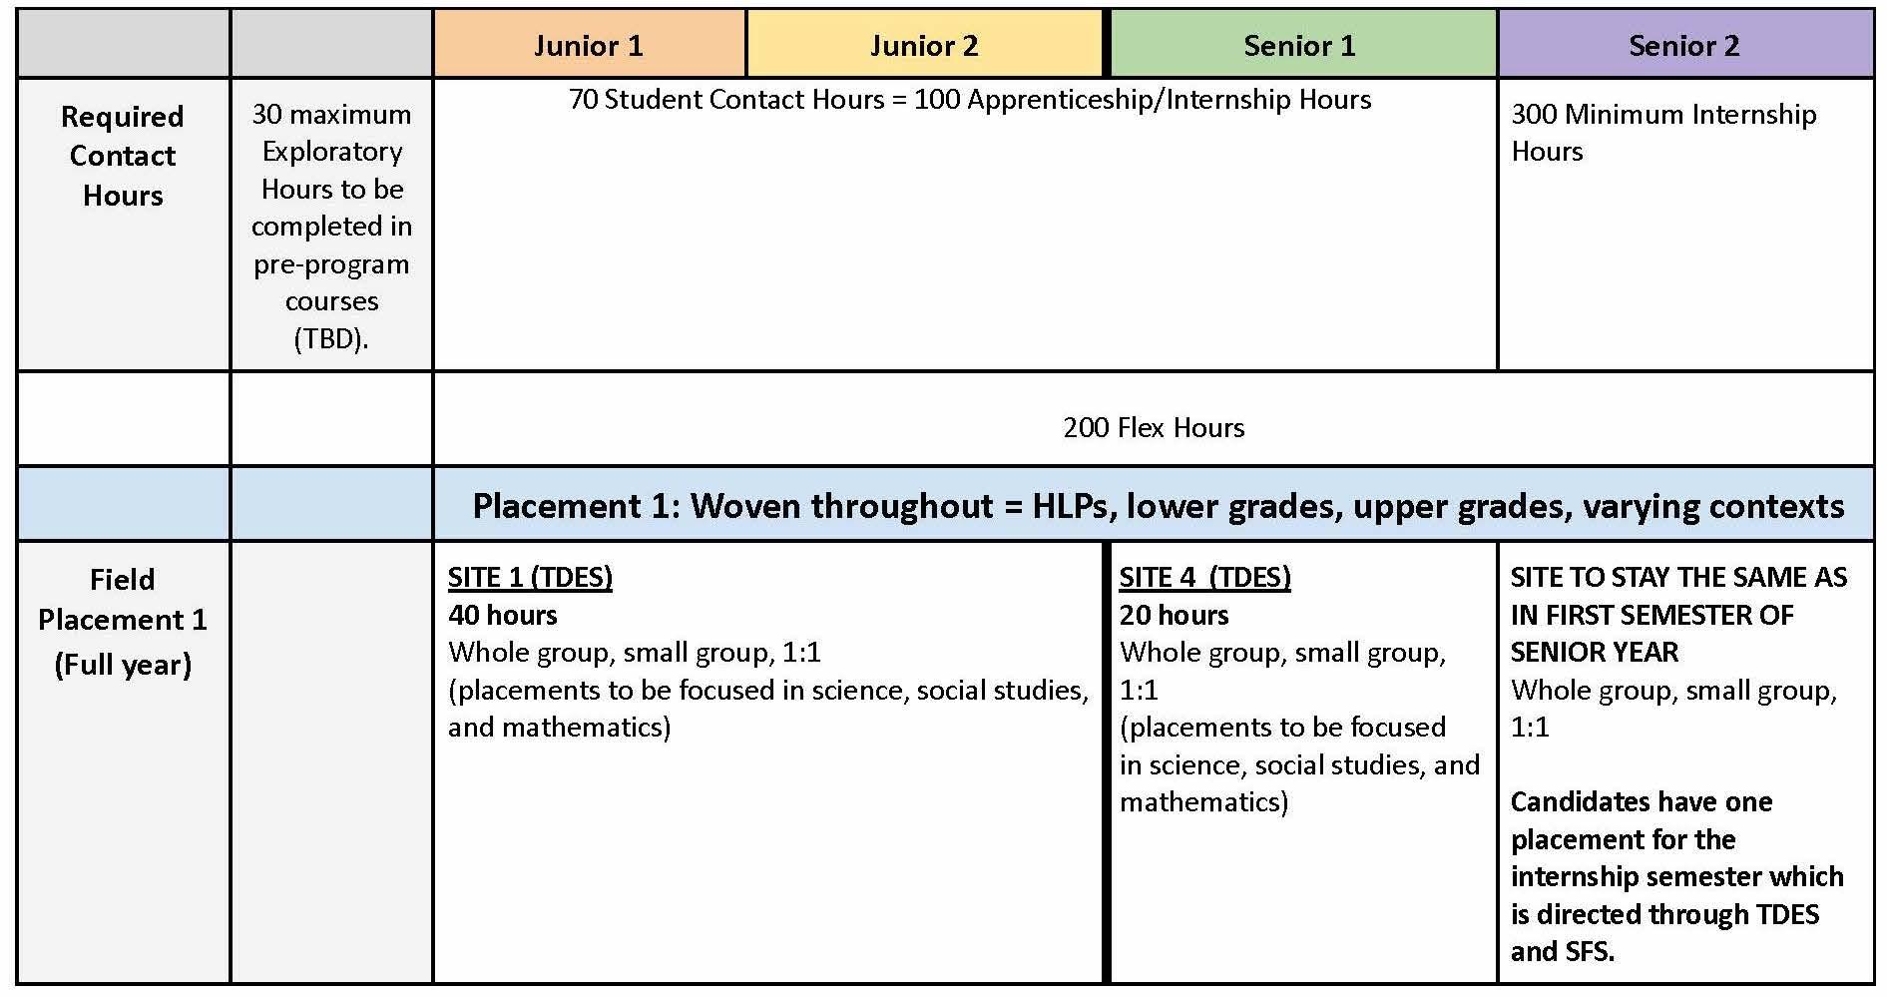
Notes:
Send them the link to the original document so that they can see the plan for themselves. These slides are for orientation purposes and won’t be discussed at length.

Slide 8
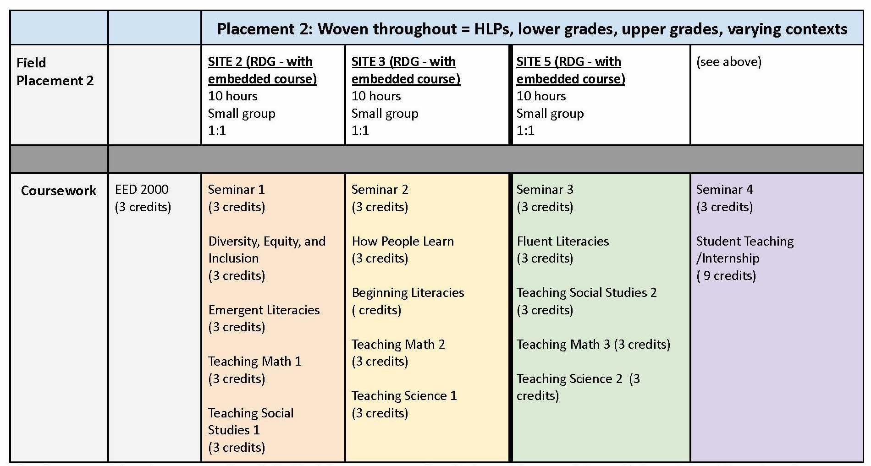
Notes:
Bringing this all together and to scale will take collaboration with RLA faculty.

Slide 9
The work of supporting novice teacher development in a cluster site:
The Systems Perspective includes:
Developing professional connections among diverse roles in both University and School District/s so the evolving design and implementation becomes joint work.
Developing shared language and processes throughout the partnership for how mentors are identified, assigned, and engaged across grade bands.
Developing shared understanding of the paradigm shifts required around teacher preparation and mentoring among diverse roles in both University and School District/s so the partnership is sustainable.
Supporting the development of skills in Core Teaching Practices in Mathematics, Science, and Social Studies (with ELA woven in) through coordination of on-campus course assignments in methods courses and Seminars (I, II, II).
Developing a research-practice partnership to assess and redesign coordination roles to support clinically rich experiences (e.g. liaisons, supervisors, course leads, program coordinators)

Slide 10
The work of supporting novice teacher development in a cluster site:
The School-based Perspective includes:
Engaging mentor teachers in a full year commitment to OU candidates as active educators in their classrooms and their school.
Engaging and facilitating mentor teachers as collaborative partners with their immediate colleagues who mentor novice teachers at different grade bands–becoming a cross grade band (PK-3/3-6) team for a year.
Engaging and facilitating mentor teachers as collaborative partners with university faculty to align coursework and clinical experiences
Engaging and facilitating mentor teachers and university faculty in continuous learning of teacher preparation
Engaging candidates’ work across the school community where needed and where opportunities arise to participate in extra-curricular programs are (e.g., Family Math Night, open house, after school programs, lunch and learn, etc.) These experiences get recorded as Flex Hours per the MDE.

Slide 11
OU/School District Partnership
at its core is the mentoring of preservice teachers
Mentor as School-based Teacher Educator:
Reflective practitioners
Share instructional responsibilities
Model Core Practices and DEI Pedagogies
Committed to professional learning and co-designing of clinical experiences
Mentor Teacher and Preservice Teachers
CHALLENGES
Responsibilities
$ Financial Resources
Professional learning

Slide 12
Partnership commitment (MOU) to creating and stabilizing a 3 legged platform for teacher education
Resources in District/School:
Instructional resources
Restructured time for mentors
Programming to support restructured time for mentors
New Responsibilities of ALL partners:
Meeting for professional learning and alignment of course content to clinical experiences
Meeting for documentation, assessment, analysis, and innovation to meet partnership goals
Professional Learning of all partners:
Teacher Development and Preparation to Teach
Clinically-Rich Programming
Research
Teacher Leadership
$ Financial Resources
Responsibilities
Professional learning

Slide 13
Mission, Vision, Values, and Goals
to be further articulated and clarified with the Director of Teacher Education and the Clinical Practices Network
Mission:
to prepare well started beginning teachers for today’s elementary children
to prepare well started beginning (elementary) students for a life of learning and contribution
Vision: partnerships that bridge academic study of teaching with clinical experiences to advance missions
Values:
Teachers as school based teacher educators
Teacher candidates as active learners in clinical experiences
Dialogue
Innovation
Reflection, Assessment, Adaptation

Slide 14
High Leverage (U of M-AA) or Core Teaching Practices (MDE)
See: https://library.teachingworks.org/curriculum-resources/high-leverage-practices/
High-leverage practices are the fundamentals of teaching. These practices are used constantly and are critical to helping students learn important content. The high-leverage practices are also central to supporting students’ social and emotional development. These high-leverage practices are used across subject areas, grade levels, and contexts. They are “high-leverage” not only because they matter to student learning but because they are basic for advancing skill in teaching.

Slide 15
MDE Core Teaching Practices
1. Leading a group discussion 2. Explaining and modeling content, practices, and strategies 3. Eliciting and interpreting individual students’ thinking 4. Diagnosing particular common patterns of student thinking and development in a subject-matter domain 5. Implementing norms and routines for classroom discourse and work 6. Coordinating and adjusting instruction during a lesson 7. Specifying and reinforcing productive student behavior 8. Implementing organizational routines 9. Setting up and managing small group work 10. Building respectful relationships with students 11. Talking about a student with parents or other caregivers 12. Learning about students’ cultural, religious, family, intellectual, and personal experiences and resources for use in instruction 13. Setting long- and short-term learning goals for students 14. Designing single lessons and sequences of lessons 15. Checking student understanding during and at the conclusion of lessons 16. Selecting and designing formal assessments of student learning 17. Interpreting the results of student work, including routine assignments, quizzes, tests, projects, and standardized assessments 18. Providing oral and written feedback to students 19. Analyzing instruction for the purpose of improving it.

Slide 16
Link to details for all Core Practices
https://www.michigan.gov//media/Project/Websites/mde/educator_services/prep/core_teaching_practices.pdf?rev=13216382a9a949c293262f9c5e0fad99

Slide 17
High Leverage Practices in Special Education
See CEEDAR Center:
https://ceedar.education.ufl.edu/wp-content/uploads/2017/07/CEC-HLP-Web.pdf
The HLPs are organized around four aspects of practice:
Collaboration
Assessment
Social/emotional/behavioral
Instruction
From these four aspects of practice, there are 22 practices intended to address the most critical practices that every K–12 special education teacher should master and be able to demonstrate. The selected practices are used frequently in classrooms and have been shown to improve student outcomes if successfully implemented.

