Slide 1
Student Safety Assessment
West Bloomfield School District
Rebecca Heitsch, Restorative Practice Coach
Lynne Swerhone, School Mental Health Specialist
Notes:
This process is not new, just in a different form and one that is consistent between buildings.

Slide 2
WBSD Student Safety Assessment
01
02
Rationale for the SSA
SSA Documents
SSA Training and Support for Counselors and SSW
04
Student Safety Support Efforts
03

Slide 3
–Jillian Peterson, psychologist and professor of criminology and criminal justice at Hamline University, The Violence Project
“During our research, we interviewed several young people who planned to do a school shooting, but changed their minds at the last minute. In every case, this was because an adult reached out and made a connection that gave them hope. School shootings are not an inevitable part of American life. We can, and must, change our approach to preventing them.”

Slide 4
Student Safety Assessment Team
Training September 3, 2020
Jason Russell, Secure Educational Consultants
District Team
created flowcharts for easy use
retyped the documents-made it our own
reviewed and practiced with documents

Slide 5
Good Threat Assessment Practices
Jason Russell, Secure Education Consultants
Steps to Developing a Threat Assessment
Develop a Team
Define Concerning Behaviors
Central Reporting Mechanism
Thresholds for Behavior
Investigative Process
Intervention Strategies
Safe School Climate
Training for Staff and Students
Key Factors in a Threat Assessment
Central point of reporting
Anonymous reporting capability
Consistent record keeping process
Focus on early interventions

Slide 6
01
Rationale for the SSA
Notes:
Lynne

Slide 7
WBSD Student Safety Rationale
Notes:
Lynne

Slide 8
10 Findings from the the Safe Schools Initiative
School Shooters-4 Things in Common
Childhood trauma
Anger over a recent event
Studied other school shootings
Means to carry out an attack
EdWeek, What School Shooters Have in Common
Incidents of targeted violence at school rarely are sudden, impulsive acts.
Prior to most incidents, other people knew about the attacker’s idea and/or plan to attack.
Most attackers did not threaten their targets directly prior to advancing the attack.
There is no accurate or useful profile of students who engaged in targeted school violence.
Most attackers engaged in some behavior prior to the incident that caused others concern or indicated a need for help.
Most attackers had difficulty coping with significant losses or personal failures. Moreover, many had considered or attempted suicide.
Many attackers felt bullied, persecuted, or injured by others prior to the attack.
Most attackers had access to and had used weapons prior to the attack.
In many cases, other students were involved in some capacity.
Despite prompt law enforcement responses, most shooting incidents were stopped by means other than law enforcement intervention.
Notes:
Lynne

Slide 9
Stats on intervention-self harm and suicide
In one review of the National Violent Death Reporting System, an identical percentage of young and early adolescent children (29%) disclosed suicide intent to another person before death.
Adolescence is the age period of the highest rates of attempted suicide, and each attempt increases risk for future attempts and death due to suicide.
Suicide is the second leading cause of death for both children and adolescents ages 10 to 17, second to only unintentional injury. Suicide ranked 10th as a cause of death for US elementary school–aged children in 2014. The suicide rate in this population is rising, particularly for Black youth.
“Credible screening and assessment tools should be incorporated in clinical practice because the use of such tools, coupled with clinical judgment, has been found to be more accurate than clinician judgment alone.5,27”
In order to effectively prevent suicides, we need comprehensive assessment, documentation of our follow up, and record of our efforts.
Notes:
Lynne

Slide 10
SSA Documents
02
Notes:
Lynne

Slide 11
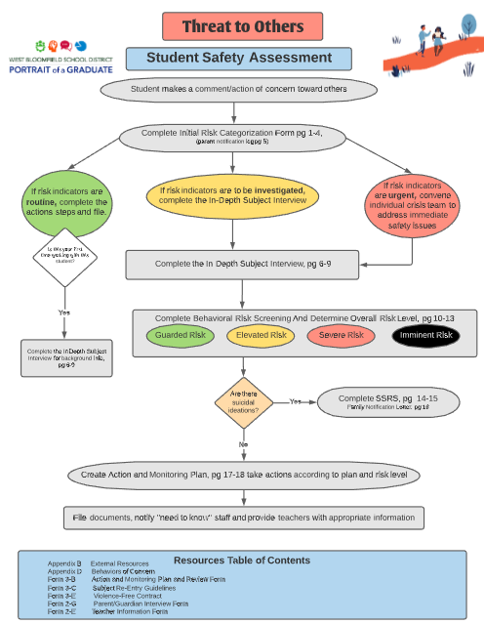
Threat to Others
Flowchart
Threat to Others Documents
Helpful Materials
In-Depth Subject Interview
Parent Interview
Teacher Interview
Student Crisis Plan
Violence Free Contract
Notes:
Becky

Slide 12
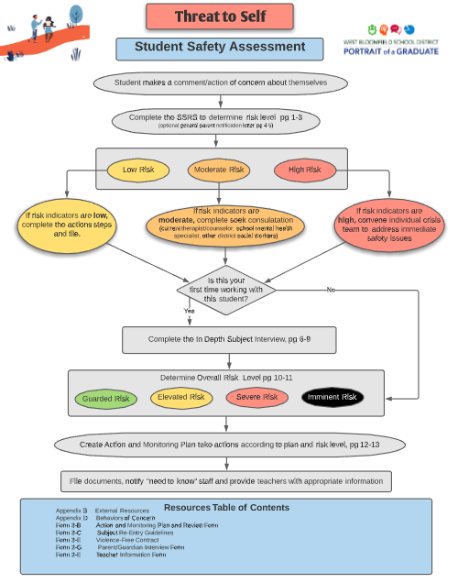
Threat to Self
Flowchart
Threat to Self Documents
Helpful Materials
In-Depth Subject Interview
Questions for Young Students
Parent Interview
Teacher Interview
Student Crisis Plan

Slide 13
03
SSA Training and Support
Notes:
Becky

Slide 14
Training and Support
Ongoing SUPPORT
Binders with tabs and all forms
Tech support with Kami
Quick Reference Guide
Follow up meetings with each grade band
Sought feedback once the forms were in use
Completing forms together and consulting
Always refining
TRAINING
All counselors, SSW, school psychologists and administrators
Rationale
Flowcharts and documents
Processing time
Scenario practice
Breakout rooms with grade band
Questions and Feedback Form
Notes:
Becky
Think-10 minutes
Pair-6 minutes
Share from three schools-8 minutes
Breakout Rooms for each school-Choose your breakout room.

Slide 15
Secure Housing of the SSA
-Forms will be completed through Kami and stored on the drive
-Do not give access to these documents to others
-Information will be transferred to the incoming student support staff during the articulation process
-MS-HS articulation spreadsheet will have a new column added for this info, “SSA”
Notes:
Becky

Slide 16
Student Safety Support Efforts
04
Notes:
Becky

Slide 17
Additional Student Safety Support Efforts
OK2Say Relaunch
On the back of ID cards (by law next year)
CPS and Mandated Reporting Review
Student Concern Flowchart for Staff
Student Surveys
Climate, Safety and Equity-Panorama
MS and HS mental health survey
In the Works
Title IX Support and Knowledge
Students, Staff, Admin and Families
Student Reporting
Notes:
Lynne

Slide 18
SSA Documents
SSA Quick Guide (contains all docs for the SSA)
SSA Binder Cover
Threat to Self Flowchart
Threat to Self Documents
Threat to Others Flowchart
Threat to Others Documents
Student Concerns Flowchart for teachers and paras
SSA Training Slides for social workers, counselors and admin
Mandated Reporter Review for teachers and school staff
Notes:
Lynne

Slide 19
Questions
Rebecca Heitsch Lynne Swerhone
Restorative Practice Coach School Mental Health Specialist
rebecca.heitsch@wbsd.org lynne.swerhone@wbsd.org
Jason Russell
Secure Educational Consultants
jason.russell@secureed.com
Notes:
Lynne

