Slide 1
Educator Workforce Updates
Krista D. Ried, Supervisor
Professional Educator Certification Services
Office of Educator Excellence

Slide 2
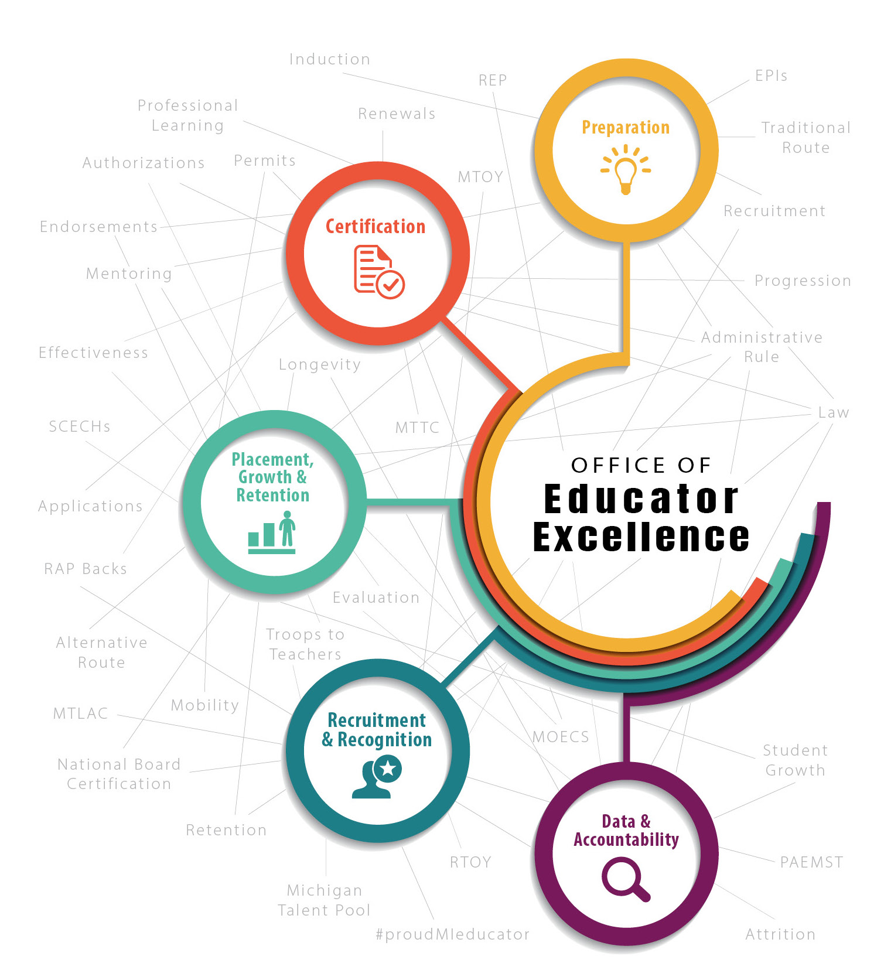
It’s all about collaboration!
Notes:
The Office of Educator Excellence is more than just teacher certification… we are more than just a pipeline for the professional. We see OEE as an ecosystem that is wholly dependent on all the parts…
OEE serves the community by providing whole-child centered resources to ensure every student in the P-20 system has equitable access to a high-quality, barrier-free system of education professionals.
This is accomplished by the recruitment, preparation, certification, development, support, retention, and recognition of educators through collaboration with internal and external partners.
I am excited to collaborate with you today!
QUICK NOTE: The QR codes found throughout this presentation will take you to either a website or a document that expands upon the information I am sharing. This QR code leads you directly to the Permits & Placement webpage for additional information. You can find all the information I am sharing today there, as well as much more!

Slide 3
Executive Orders
issues
Solutions
communications

Slide 4
Impacts of COVID-19 on Educator Certification
Big picture - fundamentally changed the way all educators are functioning in support of students
Pragmatically - the closures required flexibility and changes to handle:
Issue #1: Certificate renewals for current educators
Issue #2: Professional learning requirements for school counselors
Issue #3: Extending substitute permits
Issue #4: Granting of certificates for aspiring educators
Issue #5: Changes in educator evaluation requirements
Notes:
As you are aware, there have been a handful of COVID-19 related issues around educator certification that has impacted our workforce. We have been working with the governor’s office to help address these issues. In addition to fundamentally changing the way all educators are functioning in support of students, I will focus on the following 5 issues and how we’ve hoped to help mitigate the impact on educators.

Slide 5
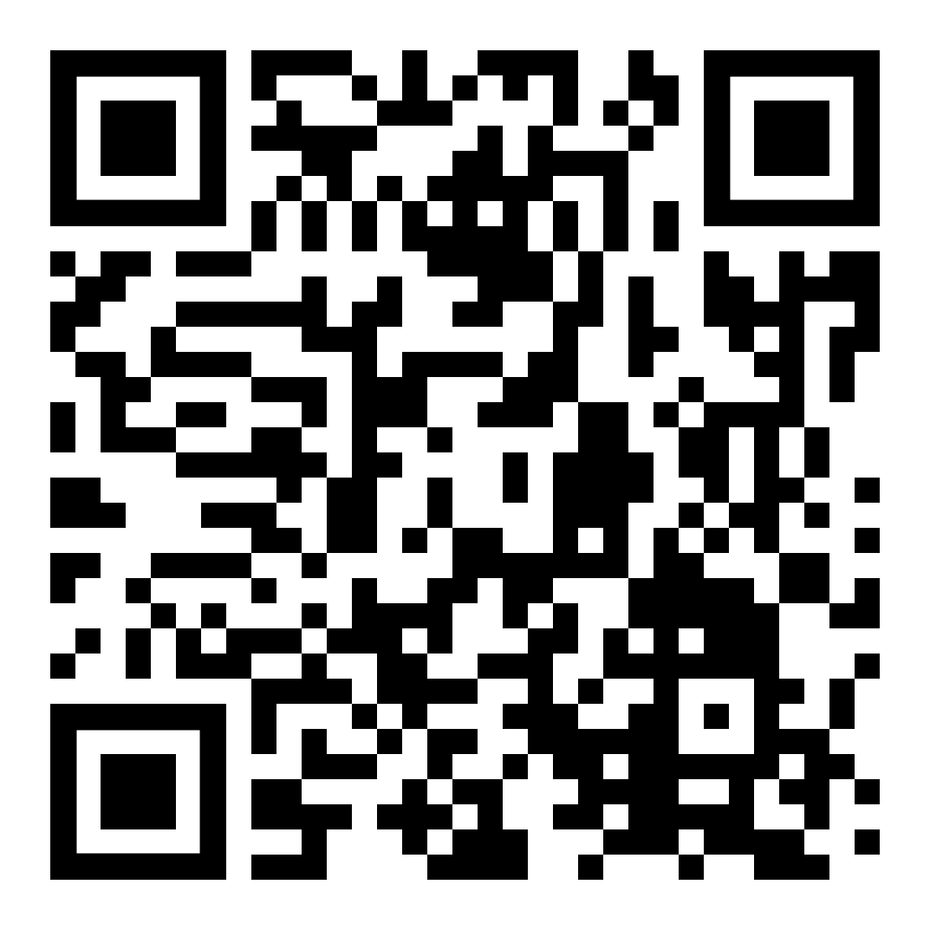
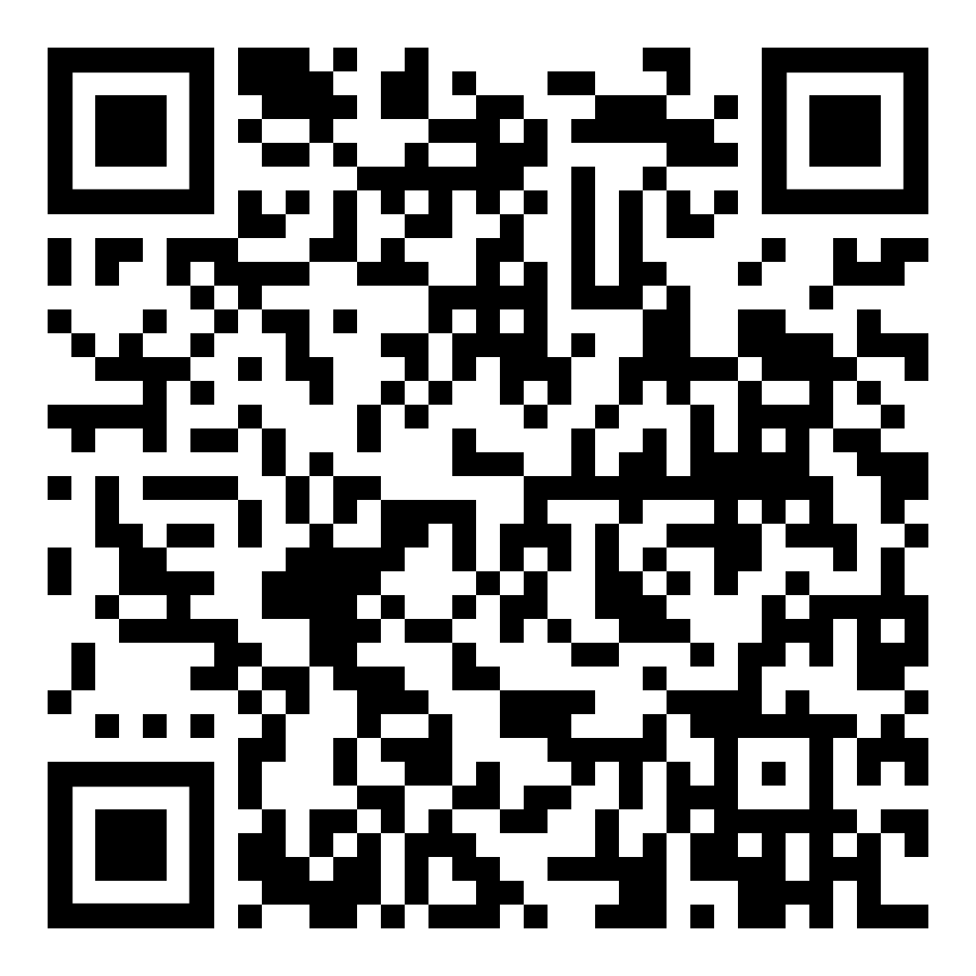
Executive Orders (E.O.)
E.O. 2020-35
E.O. 2020-65 replaced 2020-35
E.O. 2020-142 rescinded 2020-65
Notes:
Executive Orders (E.O.) 2020-35 and 2020-65 provide the authority for these changes, either with an explicit change or with expanded authority for rule waivers to the Superintendent of Public Instruction.
Executive Order (E.O.) 2020-65 replaced 2020-35, continuing everything in 2020-35 and adding more details.
E.O. 2020-142 rescinded 2020-65, but maintained provisions related to educator certification through the end of the fiscal year (Sept. 30, 2020).
Executive Order (E.O.) 2020-142 rescinded 2020-65, but maintained provisions related to educator certification, again, through the end of the fiscal year (Sept. 30, 2020)
The QR code on the left is for OEE’s specific memos pertaining to the Eos and the one on the right will take you to MDE’s COVID-19 Resources page.

Slide 6
2019-2020 School Year
Notes:
I’ve broken down the Executive Orders and issues by the school year they impact to better support the impact and continued focus of our supports. I’ll start with how the E.O.s impacted last school year (the 2019-2020) school year first…..

Slide 7
Issue #1: Certificate Renewals for Existing Educators
Requirement: 150 Education-Related Professional Learning hours (SCECHs, DPPD, and/or semester credits) over five years
Issue: professional development after March 13th cancelled
Solution: 150 hours reduced to 120 hours (2020 renewals only)
Solution: waive 2019-2020 DPPD
Solution: advertise free and low-cost online options
Notes:
Currently, there is a requirement for 150 Education-Related Professional Learning hours over five years to renew a certificate. These hours can be obtained through State Continuing Education Clock Hours (SCECHs), District Provided Professional Development or semester credit hours… any combination of the 3.
Issue: some educators who were due for renewal this year may have planned professional learning that was cancelled; may struggle to access professional learning during the pandemic
Issue: district-provided professional development planned after March 13th may have been negatively impacted
Solution: waive the requirement for 150 hours and reduce it to 120 hours for educators renewing their certificates and waive the requirements for district-provided professional development for the 2019-20 school year. Also, curated a list of free and low-cost professional learning options, many of which support teachers in transitioning to a virtual environment and support self-help and social emotional learning.
I’ll touch on this later when we talk more specifically about Education-Related Professional Learning (or ERPL) but it should also be noted here that as of July 1, 2020 all DPPD must be registered as SCECHs for it to be used for recertification.

Slide 8
Issue #2: Professional Learning Requirements for School Counselors
Requirement: MCL 380.1233b –
25 hours college preparation and selection
25 hours career counseling
Issue: professional development after March 13th cancelled
Solution: 150 hours reduced to 100 hours (2020 renewals only)
Solution: advertise free and low-cost online options
Notes:
The requirement (MCL 380.1233b) for individuals holding a school counselor license or teaching certificate with a school counselor endorsement expiring on June 30, 2020 to complete at least 25 hours of professional learning on college preparation and selection and at least 25 hours of professional learning on career counseling.
Again the issue is that educators, specifically school counselors, who were due for renewal this year may have planned professional learning that was cancelled; they may struggle to access professional learning during the pandemic
professional development after March 13th
E.O. 2020-35 waived compliance with this requirement for those with certificates expiring June 30, 2020, reducing the total number of hours required from 150 to 100 and waiving the specific requirements professional learning on college and career counseling. The free and low-cost online options mentioned for all educators included specific professional learning for school counselors as well.

Slide 9
Issue #3: Substitute Permits
Requirement: Daily Substitute Permit 90-day limitation
Issues:
Availability of testing
Ability to enroll in a preparation program
Providing consistency to students
Availability of substitute teachers
Solution: extend through August 31, 2020
Notes:
Daily Substitute Permits are valid for 90-calendar days in the same assignment. Many issues surrounded both the permitted individual and the employing school district, not the least of which were the individual’s inability to take and pass the Michigan Test for Teacher Certification (MTTC) thereby making the school eligible for transition to one of the full-year permit options.
The solution was relatively simple: The Michigan Department of Education (MDE) extended the period for daily substitute permits through August 31, 2020 without requirement to apply for additional extensions to reduce burden on local school districts.
While the E.O. did set aside the requirement for MDE to deduct state aid for lack of appropriate licensure, it did NOT set aside the requirement for appropriate licensure itself—therefore, we need to make sure permits are appropriately used and extended appropriately. It is important to note that the suspension of the state aid deduction requirement is only in effect through September 30, 2020.

Slide 10
Issue #4: Granting Certificates to Aspiring Educators
Requirement: Law and Administrative Rule
Issues:
finishing student teaching
taking a CPR course
testing availability
Solution #1- Student Teaching: other forms of evidence
Solution #2- CPR: waived CPR
Solution #3- MTTC: grant temporary certificate
Notes:
There are several issues here, including finishing student teaching, taking a CPR course as required by law, and completing the Michigan Teacher Test for Certification requirements→ all impacted by the closures.
Student teaching: provided guidance to educator preparation providers to consider other forms of evidence to allow candidates to complete student teaching
CPR: E.O. 2020-35 waived the requirement for CPR entirely. This means your new candidates may not have had it and you may want to offer it locally as soon as possible.
MTTC: E.O. 2020-35 allowed for the granting of a temporary certificate without fulfillment of MTTC until testing is allowed.
This applies to recent in-state graduates as well as out-of-state candidates, who under normal circumstances would not have qualified, AND
It should be noted that while these solutions didn’t specifically address candidates in alternate route programs, they can be employed under a substitute permit to allow them to teach until they can take and pass the MTTC.
These provisions are in effect through September 30, 2020.

Slide 11
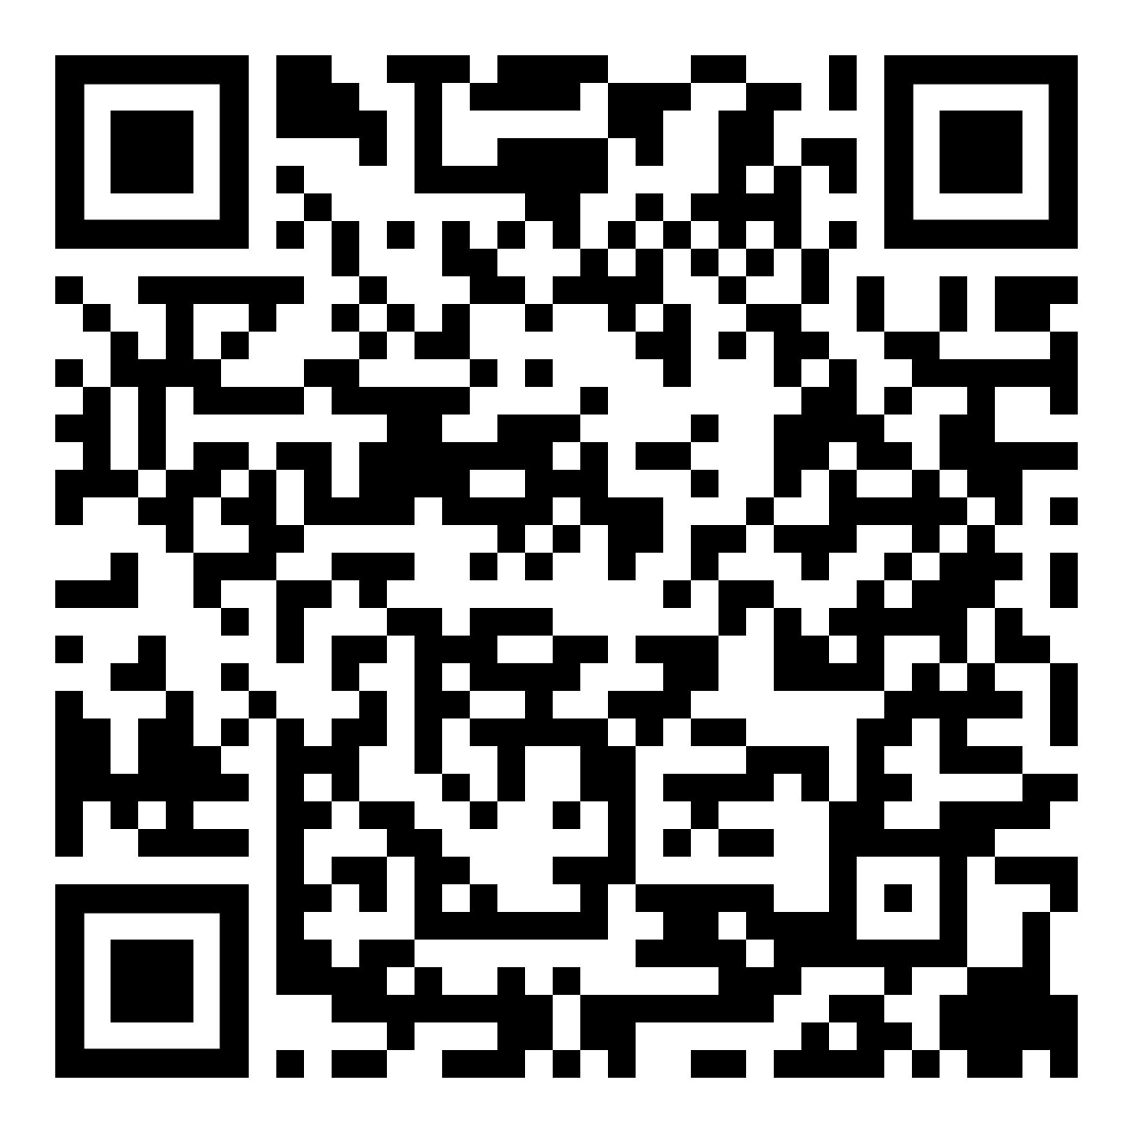
Issue #5: Educator Evaluations
Requirement: All educators require evaluation and effectiveness ratings
Issue: social distancing restrictions and online instruction and student assessment challenges
Solutions: waive requirement for individuals not on an individual development plan
Notes:
E.O. 2020-35 offered some flexibility on educator evaluations and E.O. 2020-65 went on to clarify that flexibility.
Section IV(8) of E.O. 2020-65 waives any requirement for performance evaluations of district administrators for the 2019-2020 school year. In addition, the same section waives the requirement for a vast majority of performance evaluations of teachers.
That said, teachers on an individual development plan (IDP) as of March 13, 2020 must be evaluated. These teachers include those on probationary status, as well as any teachers on probationary status or tenured teachers who had an ineffective or minimally effective rating in 2018-19.
Of course districts may evaluate other educators if they choose. Evaluations should not consider any data that could not be obtained due to closures. (e.g. student assessments that were not administered)
The reporting window for these evaluations is already closed and there are some complexities with this particular solution, so please refer to the May 13, 2020 communication linked in the QR code here for more information.

Slide 12
Preparing for 2020-2021
Notes:
The issues that still linger and will impact the 20-21 school year are as follows…

Slide 13
Certificate and Permit Renewal or Progression
Requirement: certain certificates and permits require educator evaluation
Issue: absence of observation and evaluation during 2019-2020 school year
Solution:
Permit Renewal: waive observation and evaluation requirement
Certificate: waive observation and evaluation requirement
Notes:
Some certificates and some permits require verification the educator was evaluated in order to renew or progress to the next level. With the absence of observations and the waiver of the requirement in the previous EO, a superintendent rule waiver allowed MDE to then waive the observation and evaluation requirements for the renewal of the Full-Year Basic, Full-Year Shortage, Expert, and School Administrator Permits. A certificate or permit may be renewed or progressed regardless of whether the individual received a 2019-2020 rating, if all other requirements are met.

Slide 14
2020-2021 Issues
Working within department and government authority and procedures to continue to identify and find solutions for the 2020-2021 school year
Student teaching
Testing availability
Absence of student growth data for 2020-2021 educator evaluation
Notes:
We are working within department and government authority and procedures to continue to identify and find solutions for the 2020-2021 school year. Specifically we are looking for ways to address, student teaching, testing availability, and the absence of student growth data for 2020-2021 educator evaluation.
This is not a complete list of what we have identified. The ecosystem mentioned at the beginning is pooling together to problem solve for the field. The best way to stay up to date is look for the MDE weekly Thursday communication (share it out with your colleagues) and….. [next slide]

Slide 15
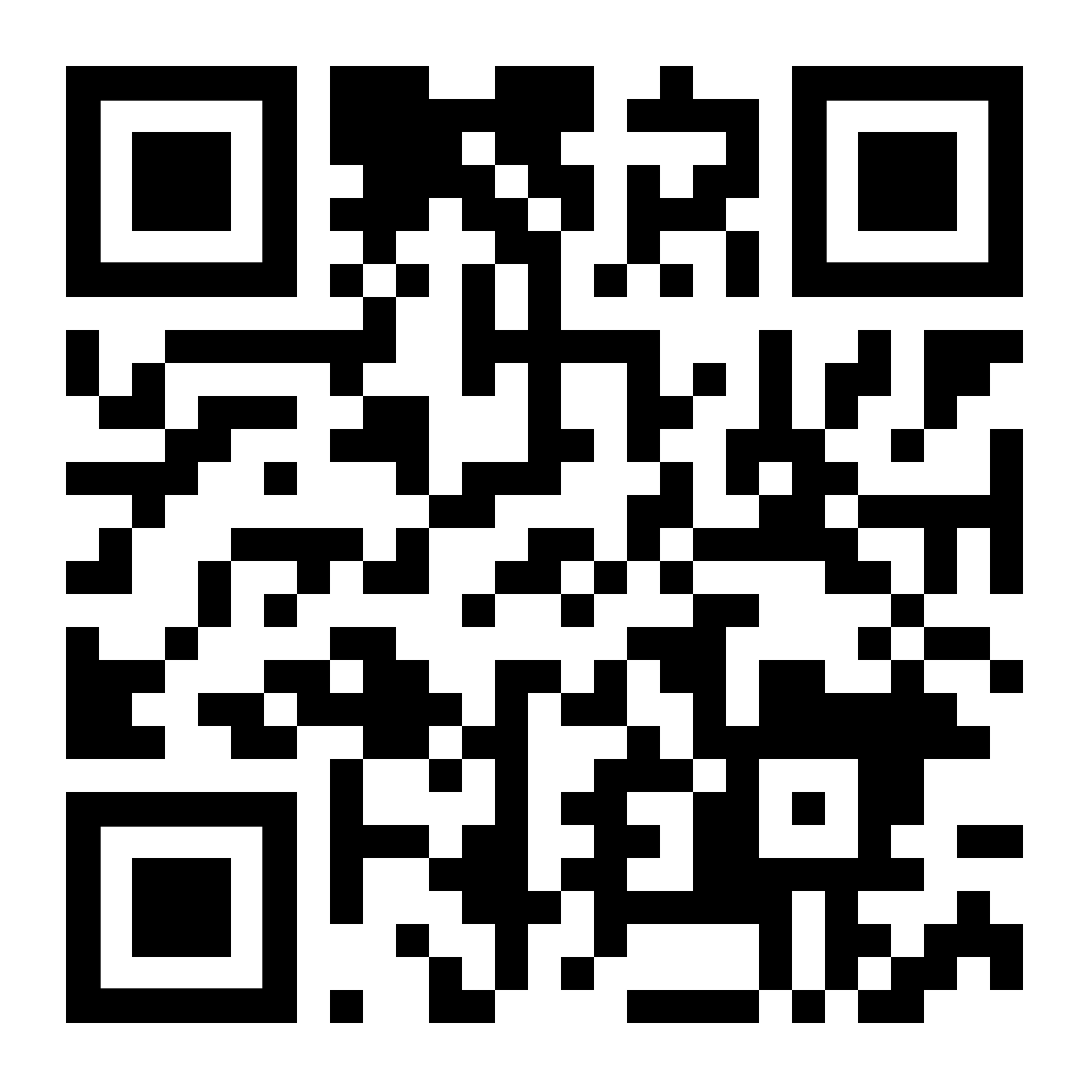
Communicating to Educators
Notes:
The MDE supports over 400,000 educators; since each of these changes impacts a certain subset of those educators, we focused on direct communication with affected individuals using the Gov Delivery tool.
We also regularly submit items for the MDE’s regular eblasts and newsletter notifications.
You may not be aware that we have launched an e-newsletter: Educationally Speaking. This newsletter is published on the third Tuesday of every month. Sign up for it!

Slide 16
Follow OEE on Social Media
Facebook/Twitter/Instagram
@MIEducator
#proudMIeducator / #PME
Notes:
1. Be sure to follow the Office of Educator Excellence on social media
2. And post about the great work happening in your school community using the hashtags

Slide 17
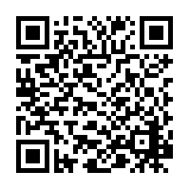
Certificate Renewal Process
5 years
5 years
150 hours of Education-Related Professional Learning
5 years
5 years
Certification Guidance Documents
Notes:
With the November 2017 revised Administrative Rules, we have established the same renewal process for all the certificates… Standard, Professional, Administrator, etc. The only exception to this is for School Counselors, which is addressed on another slide.
The educator enters a continuous loop of Education-Related Professional Learning. There are no extensions or waivers for these renewal requirements.
The renewal guidance documents for all certificates can be found on our website: https://www.michigan.gov/mde/0,4615,7-140-5683_14795_83462---,00.html

Slide 18
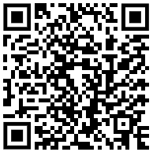
Education-Related Professional Learning (ERPL)
College Credit
SCECHs
DPPD
25:1
1:1
1:1
ERPL Guidance
Notes:
To renew, educators must obtain ONE of the following:
6 semester credit hours
150 State Continuing Education Clock Hours (or SCECHs)
150 District Provided Professional Development (DPPD) hours.
Or any combination of these three professional learning opportunities. These opportunities should be appropriate to grade level and/or endorsement(s) of the certificate the individual holds.
College transcripts are entered by the applicant and supported by college transcripts. SCECHs, the more convenient from an applicant’s perspective AND from a processing or evaluation perspective, are automatically uploaded into the Michigan Online Educator Certification System (MOECS) by a SCECH coordinator upon completion and are maintained there for future record keeping and auditing. As of July 1, 2020 all NEW DPPD must be registered as SCECHs. This is key to supporting the retention of teachers as they continue to renew or maintain their certificates. The documentation aspect of DPPD became an insurmountable stumbling block for educators as well as a statewide Auditor General finding on district record keeping processes for MCL 380.1527.
More information on Education-Related Professional Learning options and documentation can be found at in the QR code linked here: www.michigan.gov/documents/mde/Education_Related_Professional_Learning_604294_7.PDF

Slide 19
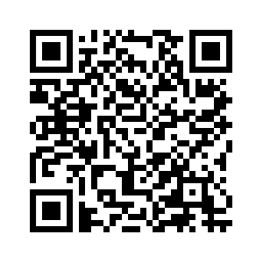
Staffing Flexibilities
Permits
Authorizations
Approvals
Notes:
Michigan’s staffing flexibilities are found within our system of permits, authorizations and approvals. Aside from certifications, Administrative Rules, Michigan law and in the case of special education, Federal law, authorize MDE to provide these flexibilities.

Slide 20
Full-year
Basic Permit
Full-year Shortage Permit
Expert Permit
Daily Substitute Permit
Special Education Approval
Annual Authorization
School Admin Permit
Notes:
We believe that we currently have a flexibility that will support just about every staffing need that has arisen. In fact, you may not know this, but Michigan has an Office of Continuous Improvement (not within the Department of Education!) and they have been recognized nationally for their work on process improvement. In consultation with their staff, the goal for implementation of policy and processes should be to meet 80% of needs of a particular user.
I feel pretty confident that we are closer to 90% with our current flexibilities.
Stakeholders were convened several years ago to redesign this system and address exceptions to certification. Will there be exceptions to these exceptions? Of course! There always are. I won’t have time to talk specifically about these one-offs today, but firmly believe that providing guidance, training, and transparency is vital. We need schools to use this system of flexibilities appropriately as this allows us to collect data for analysis and future adjustments if/when needed.
The basic key points for all of these flexibilities include:
Permits and Authorizations must be valid and fee paid prior to placement
Take note of renewal requirements in advance of next year’s staffing decisions
Out-of-state certificates are NOT valid in lieu of Michigan certification or a permit
Focus on district/school supports necessary to usher candidates through a transition from Daily to Full-year to obtaining certification (Grow-Your-Own)

Slide 21
Daily Substitute Permit
60 semester credits
Intermittent assignments
90-consecutive calendar days same assignment
Not required for CERTIFIED teachers (90 days)
Extension available
Age limitation removed
Notes:
The most common of our permits, the Daily Substitute Permit is designed for intermittent assignments. An intermittent assignment is defined as no more than 90-consecutive calendar days in the same assignment.
As a minimum standard, law sets the requirement of 60 semester credits hours. These credits do not need to be consolidated on a single transcript, but at this time must be from a regionally accredited institution.
Important notes about this permit…
Most recent change reduced the minimum requirement specified in law (MCL 380.1233) from 90 semester credits to 60. (enables schools to throw a wider net)
This change also removed the temporary age restriction in place for part of the 2017-18 school year. (you may not have even know this was in law for a hot minute!)
The Daily permit provides legal placement coverage for 90-consecutive calendar days.
This permit is not required for a certified teacher for the first 90-calendar days they are teaching outside the subject areas or grade levels of endorsement. A certified teacher can be placed outside their area of certification for 90-consecutive calendar days WITHOUT a permit.
This permit can be extended for an additional 90-calendar days upon application. This option should be used judiciously as you work closely with the individual to meet the requirements of the full-year permit options (e.g. testing in core areas).
An additional EMERGENCY Extension to this permit may be available but requires individual approval by the State Superintendent. At this time OEE is unclear on Dr. Rice’s intention of approving any of these. Looking at all other viable options and being proactive in your support of the individual meeting another permit’s requirements is strongly encouraged.
And, of course, as indicated on the previous slide, permits must be valid and fee paid prior to placement.

Slide 22
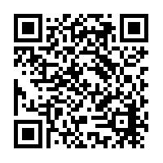
Year Long Permits – Key Points
60 semester credits
Testing for core subject areas
No state salary/pay restrictions
“Available for the Assignment” defined
Notes:
Basis of all PERMITS – 60 semester credit hours, the Full-year Permits are no exception (for those of you who have been working with permits for more than 10 years, this was NOT always the case!)
Only for CORE subject areas, is testing required.
There are no state-level restrictions on how a school pays permitted individuals.
The most common misconception, however, involves the following guidance:
If a school wishes to employ a non-certificated individual, that must maintain documentation and certify an appropriately certificated educator is not available for the assignment.
The district has sole discretion to determine whether a certified individual is available for the assignment (focus on availability vs. appropriately certificated)
If a district determines that a qualified and certified educator is NOT available, the district may take advantage of the flexibilities offered through the permit system.
This documentation is really for the school’s protection and not for MDE’s. Regular complaints from certified teachers being passed over for employment come through OEE and they are re-directed to their lawyers. For more information on this, please review OEE’s Available for Assignment Definition linked here and available through the QR code.
Take note of renewal requirements in advance of next year’s staffing decisions.
Focus on district/school supports necessary to usher candidates through a transition from Daily to Full-year to obtaining certification (Grow-Your-Own).
Out-of-state certificates are NOT valid in lieu of Michigan certification or a permit.
I’ll speak directly to the NEW School Administrator Permit, it’s validity and how it is designed to support law (MCL 380.1246) later in this presentation.
Additional Guidance:
Permits and Placement website: https://www.michigan.gov/mde/0,4615,7-140-5683_14795_83467---,00.html
available for the assignment
https://www.michigan.gov/documents/mde/Assignment_Availability_634900_7.pdf

Slide 23
Full-year Basic Permit
60 Credits
Mentor
Core Knowledge
Renewals
Year 2: Enrollment & E/HE ratings
Years 3-4: 6 credits & E/HE ratings
Notes:
This full-year permit can be obtained in core areas, non-core areas, electives, special education and non-CTE career pathway courses.
To obtain the Full-year Basic Permit for an individual who is not endorsed or certified for an assignment, the school must verify or provide the following requirements:
The individual must have documentation that they have successfully completed 60 semester credits hours, as required in law. This is the exact same requirement as the Daily Substitute Permit.
If the assignment is for a core subject area, the school must verify that the individual has sufficient content knowledge. This is done by way of having a major in the subject (or related subject) OR testing. The tests are automatically populated in the system and a Full-year permit is auto-approved upon application when the test is matched to the SSN. Non-core subject area permits are auto approved!
Additionally, the individual should be provided a mentor teacher with experience and/or expertise. This is vital for retention and building a schools staffing capacity.
Posting and advertising is no longer a requirement. MDE recognizes that schools have a wider variety of tools to seek out potential job candidates than just a newspaper or college job bulletins. However, we still strongly encourage schools to seek out and partner with the Michigan college & universities offering specific preparation program for which they have vacancies.
https://mdoe.state.mi.us/moecs/PublicProPrep.aspx
Renewals
The first renewal requires that the individual enroll in a preparation program and have either an effective or highly effective rating on a formal observation.
Subsequent renewals require progress in the preparation program with a minimum of 6 semester credit hours and continue to have either an effective or highly effective rating on a formal observation.
The renewal requirements should not be an after-thought, but should be addressed proactively as a part of the supports you provide to these “new teachers.”

Slide 24
Full-year Shortage Permit
Tier 2 Certificate Holder
0.5 FTE or less
Core Knowledge
Renewals
Year 2 - 4: E/HE ratings
Notes:
This full-year permit can be obtained in core areas, non-core areas, electives, and non-CTE industrial technologies (e.g. career pathway courses). It is not available for special education assignments.
To obtain the Full-year Shortage Permit for an individual who is not endorsed or certified for an assignment, the school must verify or provide the following requirements:
The individual must hold Michigan’s second tier certificate or higher. This includes the Professional, 18-Hour Continuing, 30-Hour Continuing, Life and Permanent Certificates.
If the assignment is for a core subject area, the school must verify that the individual has sufficient content knowledge. This is done by way of having a major in the subject (or related subject) OR testing. The tests are automatically populated in the system and this permit is also auto-approved upon application when the test is matched to the SSN. Non-core subject area permits are auto approved!
Renewals
All renewals simply require that the individual have either an effective or highly effective rating on a formal observation.
If more than 0.5 FTE is required for the assignment, the Full-year Basic Permit must be utilized.
If the holder does not have the second-tier certificate, the Full-year Basic Permit must be utilized.

Slide 25
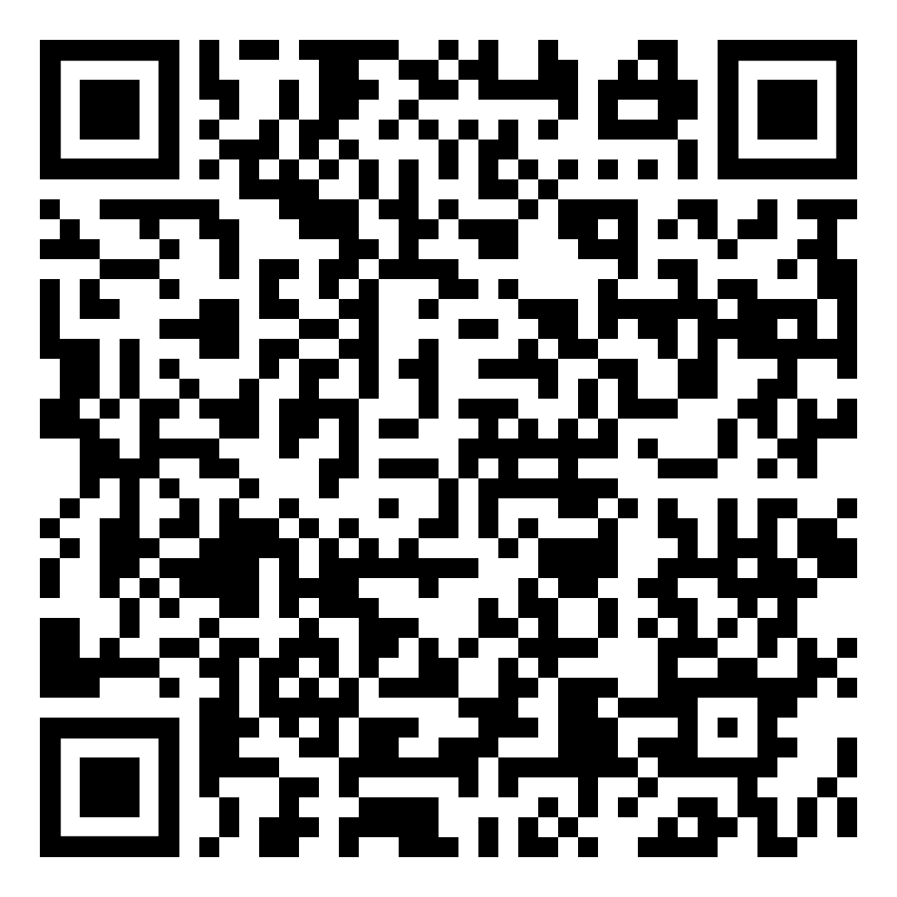
Adding Endorsements
Complete an….
approved endorsement program
Michigan
Traditional: college or university
Alternative route
Another state’s approved program
Traditional: college or university
Alternative route
MTTC
On an
Out-of-state Certificate
Notes:
This is the appropriate time to talk briefly about the process to ADD endorsements….
There are many misconceptions out there and we’d like to first dispel these two myths:
1. You don’t need to complete an entire master’s degree to add an endorsement. While there are a small number that do (e.g. Reading Specialist, Teacher Leader), these are typically not REQUIRED endorsements and are designed to elevate the professional and develop more of a career ladder.)
You can’t just test to add an endorsement either.
IN-STATE
Complete:
a Michigan approved endorsement program through:
a Michigan college or university
a Michigan approved alternative route program
take and pass the Michigan Test for Teacher Certification aligned content exam
OUT-OF-STATE:
another state’s approved endorsement program
obtain the endorsement on a valid, standard out-of-state teaching certificate
take and pass the Michigan Test for Teacher Certification aligned content exam

Slide 26
Expert Permit
BA/BS+
0.5 FTE
Expertise
Experience
Core Knowledge
Core
AND
Non-Core
60 Credits
BA/BS+
OR
Renewals
Year 2 - 4: E/HE ratings
Notes:
The Expert Permit is quite unique. It really provides a lot of creative staffing options and can support community collaboration and business partnerships.
There are essentially 2 pathways to qualify for this permit. Core and non-core:
Core
If the assignment is for a core subject area, Bachelor’s or higher degree is required.
The school must also verify that the individual has sufficient content knowledge. As with the other full-year permits, this is done by way of having a major in the subject (or related subject) OR testing. The tests are automatically populated in the system and a permit is auto-approved upon application when the test is matched to the SSN.
Non-Core
If the assignment is for a non-core subject area, the Bachelor’s or higher degree is only required as an alternative to the individual having an applicable or available business or industry license matching the assignment.
Otherwise, the individual need only have 60 credits & the available license. These licenses are issued by the Michigan Department of Licensing and Regulatory Affairs (LARA). They have a searchable database.
In both pathways, the individual must have evidence of unusual distinction or exceptional talent. What qualifies them as an “expert?”
For all areas, aside from world languages, the school must verify that the individual has 5 years or more years of successful work experience.
Renewals:
All renewals simply require that the individual have either an effective or highly effective rating on a formal observation.

Slide 27
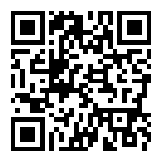
MCL 380.1233b
Career Authorizations
state-approved CTE programs
6-12 non-CTE “industrial technology education programs”
MCL 380.1233
Notes:
Now for Career Authorizations. These Authorizations have had a heavy legislative focus in the past 5 years. In accordance with recently revised law (MCL 380.1233b and MCL 380.1233), the issuance of Annual Career Authorizations (formerly known as Annual CTE Authorization or Occupational Authorizations) can be utilized for employing either of the following non-certified individuals:
Individuals from business and industry to instruct in a state-approved Career and Technical Education (CTE) program;
Individuals from business and industry to instruct in a 6-12 non-CTE industrial technology education program (e.g. career pathway courses).
The two laws cited here outline the basics on this flexible staffing solution, I’ll try to summarize our guidance in the next 3 slides.
Link to MCL 380.1233b: http://www.legislaure.mi.gov/documents/2015-2016/publicact/pdf/2015-PA-0173.pdf

Slide 28
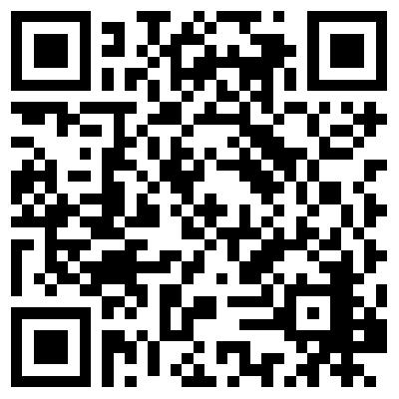
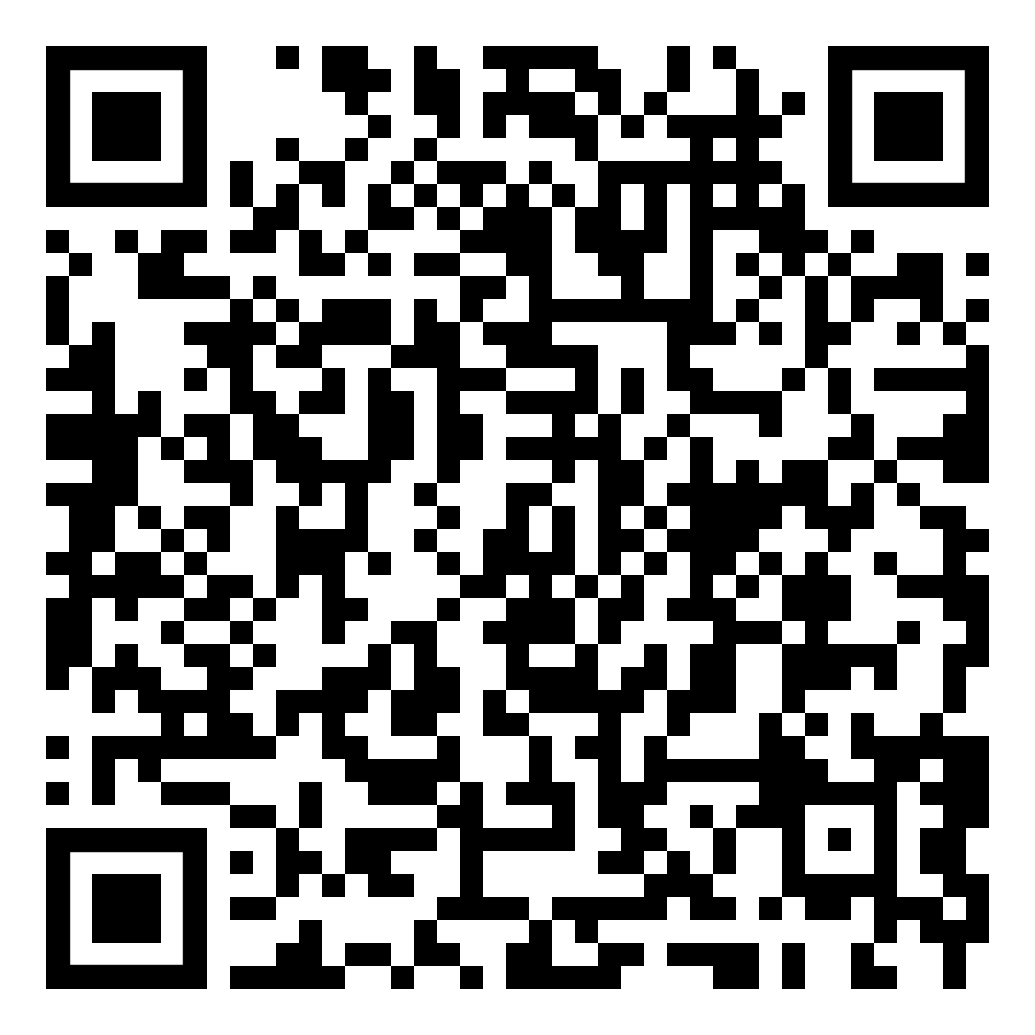
Annual Career Authorization Requirements – part 1
High school diploma or GED
Confirm certified and endorsed candidate NOT available for the assignment
Assigned a mentor
Verify work experience CTE: Recent and Relevant Experience Requirements
Notes:
If a school district wishes to employ a non-certificated teacher, that district must maintain documentation and certify an appropriately certificated educator is not available for the assignment.
The district has sole discretion to determine whether a certified individual is available for the assignment
If a district determines that a qualified and certified educator is NOT available, the district may take advantage of the flexibilities offered through the permit system.
First-year issued authorizations must meet the following requirements:
Confirm properly certified and endorsed candidate is NOT available for the assignment: https://www.michigan.gov/documents/mde/Assignment_Availability_634900_7.pdf
The district must verify the applicant’s work experience meets the recent and relevant requirements specified in the CTE guidance document: https://www.michigan.gov/documents/mde/CTE_Recent_and_Relevant_Experience_657064_7.pdf
Applications are submitted through the Michigan Online Educator Certification System (MOECS). Only the employing district may apply for an Annual Career Authorization. For questions about the use of experience, contact the appropriate CTE program consultant.

Slide 29
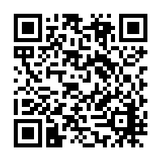
Annual Career Authorization Requirements – part 2
If required…
Business or industry license or certification
Valid vs. expired
Notes:
For teaching in a subject or field in which a business or industry license or certification is required, at least ONE of the following is required:
Holds a professional license or certification in that same subject matter or field.
Previously held a business or industry license or certification in that same subject matter or field that expired no more than two years before the noncertificated, non-endorsed teacher's initial employment under this section and was in good standing immediately before the license or certification expired.
The individual must be assigned a mentor teacher.
The Annual Career Authorization must be applied for, approved, and the fee paid prior to the individual entering the classroom.
More information on the ACA is available here: https://www.michigan.gov/documents/mde/AOA_530858_7.pdf

Slide 30
Renewing an ACA
Maintain experience
Mentor
Effective or highly effective
Notes:
To renew an ACA, the employing school must:
Verify the individual maintains hours of experience in accordance with the CTE: Recent and Relevant Experience Requirements.
Continue with an assigned mentor teacher.
Teacher has received a rating of effective or highly effective through his/her teacher evaluations.
The authorization must be applied for, approved, and the fee paid prior to the individual entering the classroom for each school year.
The school district or nonpublic school may apply no more than nine (9) times for renewal of an ACA, unless the Superintendent of Public Instruction grants a waiver at the request by the school district or nonpublic school. As a reminder 2018-19 school year was the first year of this authorization under current law.

Slide 31
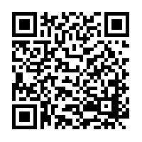
Special Education Approvals
School Social Workers
Special Education Administrators
Special Education Teachers
Special Education Supervisors
Special Education Directors
Notes:
Similar to a permit or an authorization, the Administrative Rules for Special Education allow for the issuance of an approval.
Viewed as an alternative route by the U.S. Department of Education, this approval enables a teacher to be placed in a special education funded program while they complete the requirements to be endorsed in the special education category needed for the assignment.
Certification or licensure requirements include holding the appropriate valid Michigan credential.
Renewal Requirements are different than permit requirements.
These are all in the process of being shepherded into MOECS and we are very excited about the opportunity to streamline and support these unique staffing opportunities. In 2018 and 2019, OSE and OEE are provided specialized training on these around the state. If you are interested in viewing one of these training sessions, they have been recorded for easy access. Let me know after the presentation and I can provide you that information.
https://www.michigan.gov/mde/0,4615,7-140-6598_88188_40121---,00.html

Slide 32
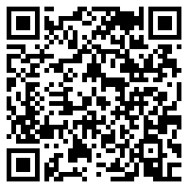
School Administrator Permit
Program Enrollment
3 years
MCL 380.1246
Notes:
The newest permit in the arsenal is the School Administrator Permit. This permit is designed to support the implementation of MCL 380.1246. Law allows schools to employ non-certified administrators as long as they enroll in a program leading to the School Administrator Certificate. They must enroll within 6 months. Unlike the other permits, there is a maximum of 2 renewals as the law limits placement without certification to 3 years.
If an Administrator does not have a valid Michigan certificate, they must hold a permit.
If a school administrator is in the position for more than six months and hasn’t enrolled in a program, even under a permit, the school and administrator are not in compliance with law and subject to a State Aid deduction.
Rules do not supersede law.
Refer directly to the law for additional clarification: http://legislature.mi.gov/doc.aspx?mcl-380-1246
Additional guidance is available: www.michigan.gov/documents/mde/School_Administrator_Permit_and_Renewal_605462_7.PDF

Slide 33
Why Would I Need a School Administrator Permit?
MCL 380.1246(3)
Time to renew
Interim positions
Out-of-state evaluations
7/29/2020
Notes:
We are regular asked about the purpose of the Administrator Permit. These are the basis for the development of this particular staffing flexibility:
The law requires that a school shall not continue to employ a person as a superintendent, principal, assistant principal, or other person whose primary responsibility is administering instructional programs or as a chief business official unless the person either holds a valid school administrator certificate OR meets the legal requirements under what is commonly known as the “grandfathered” school administrator. MCL 380.1246 (3) provides for the hiring or employment WITHOUT either of these for 6 months at which time they must enroll in a preparation program to become certified. The permit would cover this 6-month period of employment.
Additionally, those who hold Michigan School Administrator certificates may need additional time to meet the professional learning requirements necessary to renew…. Additional time to accumulate the Education-Related Professional Learning hours.
We occasionally hear from retirees who have selected NOT to renew their certificates and are offering to serve in interim positions of less than six months.
And finally, candidates moving to Michigan and making that certification transfer may need time (again, less than 6 months) to applying for their Michigan certification. It should be noted that the evaluation process does NOT take 6 months on the part of our OEE evaluators.

Slide 34
Administrator Permit Renewal
Enrollment within six months
Program course of study
Effective or highly effective
2/11/2021
Notes:
If you have someone working under a School Administrator Permit, please note that there is no work-around for the 6-month enrollment requirement. It is clearly specified in law and aside from an EO (which we’ve seen a lot of lately due to extremely unusual circumstances) there is no waiver of law. Enrollment in an approved school administrator preparation program within six months from date of hire is required. The employing district maintains documentation of the program course of study. It does not need to be submitted to MDE unless there is a specific audit request.
Additionally, a formal observation in the previous school year that resulted in a rating of effective or highly effective is required for the first renewal and subsequent renewals.

Slide 35
Preparation Programs

Slide 36
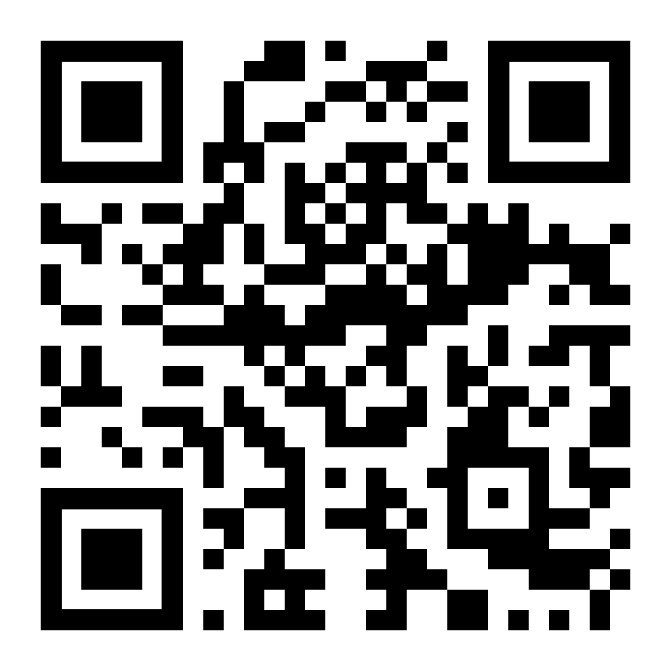
Preparation Programs Types
Traditional Programs
Accelerated Residency Programs
Career and Technical Education
Expedited Programs
Alternative Routes to Teacher Certification
Notes:
In order to support the work of recruitment, finding teachers for the positions we need filled, it is important to understand the preparation process.
We continue to battle two pervasive myths regarding preparation….
1) you don’t need another degree program; and
2) there are accelerated programs (expedited and residency) in which people can do clinical experiences within their schools.
Michigan law and rules require that all individuals complete an approved preparation program (e.g., math, elementary, English) in order to become a certified teacher in Michigan. And even traditional programs, once a person holds a bachelor’s degree, isn’t always the 4-5 year program that immediately jumps to people’s minds. Additionally, alternative route programs are now well established. For more information on how to become a teacher and a shareable link, utilize the QR code (http://bit.ly/2XmPkkF).

Slide 37
Accelerated Residency Programs
bachelor’s degree
expertise and/or demonstrated skills in specific fields
full-time teacher
working toward certification
reading coursework
MTTC content examination
Utilize Full-year Basic Permit
Notes:
The accelerated residency pathway is designed for individuals who are interested in being employed as a full-time teacher and working toward certification at the same time. Individuals must have completed a bachelor’s degree and have expertise and/or demonstrated skills in specific fields. The required reading coursework is embedded throughout program coursework. Passage of Michigan Test for Teacher Certification (MTTC) subject area examination is required before recommendation for certification.

Slide 38
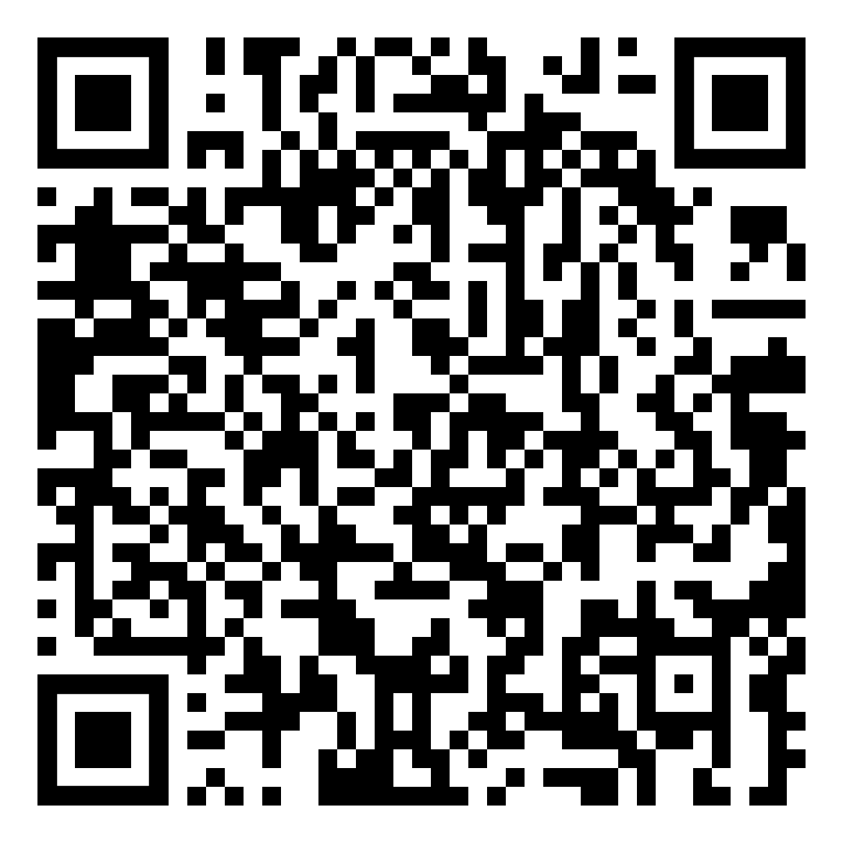
CTE Programs
bachelor’s degree
major/minor
work expertise
6 CTE education credits
Notes:
To become certified as a CTE teacher in Michigan, candidates must:
Hold a bachelor’s degree in any area
Hold a major or minor in the field of specialization in which CTE certification is being requested.
Document work experience in the CTE area that has been earned within the last 10 years totaling a minimum of 2 years (4,000 hours).
Complete a minimum of 6 semester credit hours of professional or CTE education credit
The degree can come from any regionally accredited university, however the CTE education credit must be completed through a state approved CTE preparation program.
More on CTE programs and CIP codes…. Areas that have career & technical programming… can be found in the QR code.

Slide 39
Alternative Routes
K-12 School
Educator Preparation Program
Educator
Interim Teaching Certificate
Valid for 5 years
Requires Coordination with:
Notes:
Michigan currently has 7 approved alternate route providers:
Professional Innovators in Teaching
Michigan Teachers of Tomorrow
#TEACH
Network of Michigan Educators
Leading Educators
Kent ISD
Macomb ISD
All of these routes provide the individual with the opportunity to hold an Interim Teaching Certificate. The ITC is valid for 5 years and authorizes their placement in a Michigan school while they work to complete the program. Similar to a permit, authorization, or approval in that way… the main differences are that it is held by the individual and it links together the school, the prep provider and the educator themselves. This drives and is intended to ensure coordination and collaboration with the 3 parties resulting in a well prepared educator that remains in the classroom and continues to fill a schools staffing needs.

Slide 40
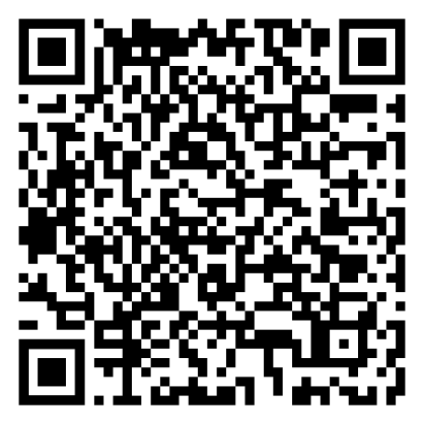
Using Permits Innovatively
Current Certified Staff
Student Teachers
Paraprofessionals
Career Changers
Community Members
Out-of-State
Short-term and long-term
Notes:
A thorough understanding of the flexibilities permits, approvals, and authorizations provide along with an understanding of the certification pathways available can really support short and long term staffing needs. It is important that we work together to GROW the teaching profession. Let’s talk briefly about our pool of candidates and how we can support them.
https://www.michigan.gov/documents/mde/Grow_Your_Own_Addressing_Vacancies_and_Shortages_620643_7.PDF

Slide 41
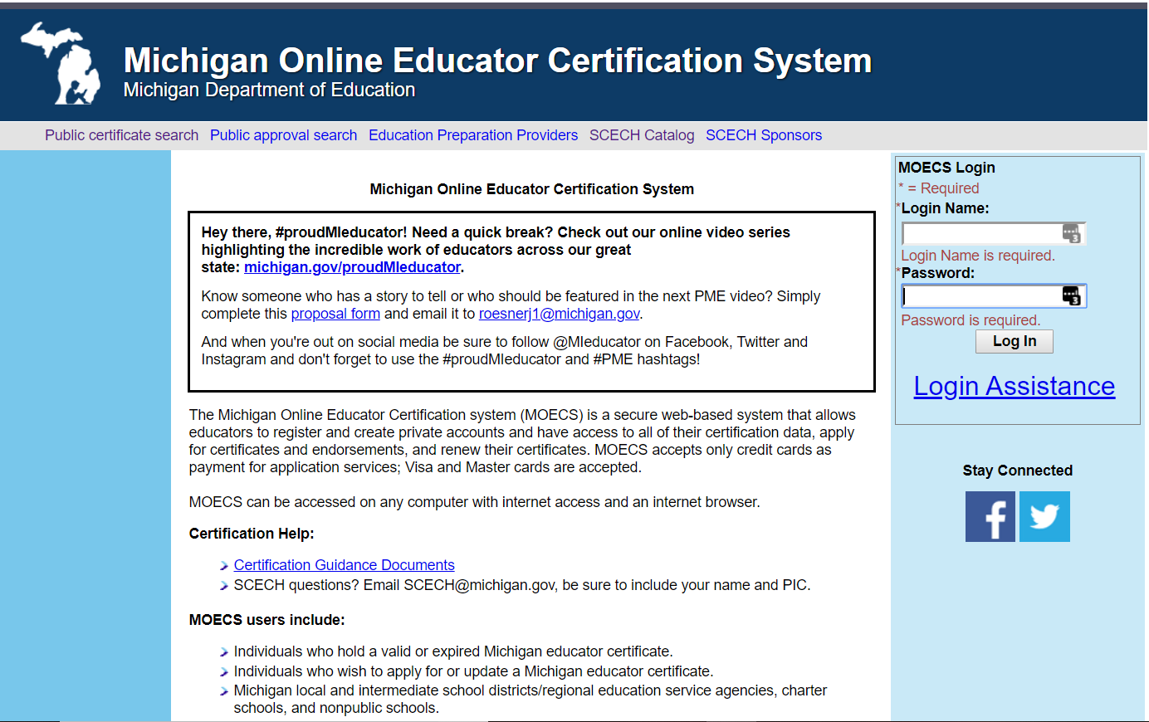
Notes:
Supporting educators in maintaining their existing certification is vital to this work. Our certification guidance documents can continue to found on our website to support these efforts.

Slide 42
Current Certified Staff
First 90-Calendar Days “free!”
Special Education Approvals
Full-year Shortage Permits
Full-year Basic Permits
EPP Partnership:
Alternative Route Programs: Additional Endorsements
Interim Teaching Certificate
Accelerated Residency Programs
Notes:
These options work best for current certified staff.
What are their particular needs?
How can schools support them? Encourage them? Recognize them?

Slide 43
Student Teachers
Full-year Basic Permits
EPP Partnerships
Accelerated Programs
Residency Programs
Traditional Programs
Notes:
Do you get many student teachers? How can you retain them to fill your vacancies?
What are their particular needs?
How can schools support them? Encourage them? Recognize them?

Slide 44
Paraprofessionals
EPP Partnerships: Interim Teaching Certificate
Alternative Routes
EPP Partnerships: Full-year Basic Permits & Annual Career Authorizations
Accelerated Residency Programs
Traditional Programs
CTE Programs
Notes:
Paraprofessionals and other non-certified educators are a grade source for potential teachers.
How do you currently use them to fill your vacancies?
What are their particular needs?
How can you develop them to fill your vacancies long-term?
How can schools support them? Encourage them? Recognize them?
DON’T FORGET CADET PROGRAMS!!

Slide 45
Career Changers
EPP Partnerships: Interim Teaching Certificate
Alternative Routes
EPP Partnerships: Full-year Basic Permits & Annual Career Authorizations
Accelerated Residency Programs
Traditional Programs
CTE Programs
Notes:
Career changers are out there looking for jobs!
How are you job postings written? Do they exclude these individuals as potential candidates?
What are their particular needs?
How can schools find them? support them? Encourage them?

Slide 46
Community Members
Expert Permits
Annual Career Authorizations
Notes:
Community collaboration and job embedded instruction, beyond the world of CTE and Perkins funded programs is becoming more and more common.
While these individuals are often best suited for elective courses, exploratory or career pathway courses, the use of the permit expand a school’s course offerings more often than filling existing vacancies.

Slide 47
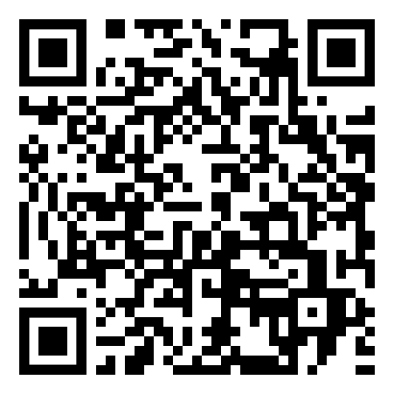
Out-of-State Candidates
What is “Reciprocity”
Professional as initial (no test)
T2EA (time to test)
only 2% of applications denied
Accompanying Supports:
Special Education Approvals
Permits
Authorizations
Notes:
“Reciprocity” seems to be a term that regularly pops up in staffing discussions but has a very inconsistent or limited understanding. Michigan has signed on to the National Association of State Directors of Teacher Education and Certification (NASDTEC) for all states in the U.S. and territories. We also have a reciprocal agreement with 4 Canadian provinces. While we do not have reciprocal agreements with the other provinces, we do have a process to support educators prepared in all other countries and regularly support their successful attainment of a Michigan certificate.
The most common aspects of reciprocity that educators are unaware of are:
Teachers can come to Michigan and obtain the Professional as their initial (no testing required)
Those that do not qualify for the Professional as their initial and are certified in another state can qualify for the Temporary Teacher Employment Authorization (or T2EA) so that they have a year to take Michigan’s content tests as prescribed by law.
Only 2% of applications from out-of-state applicants are denied
Michigan Reciprocal Out-of-state Challenges:
Cross-categorical special education programs (e.g. Mild-Moderate Disabilities)
Un-documentable alternative routes
Un-documentable alternative routes to cross-categorical special education programs
Foreign applications: requires course-by-course evaluation of transcripts, courses, credentials and degrees
Additional endorsements
Solutions: Use permits, approvals, and authorizations!
The Special Education Approvals can be used with the T2EA.
Daily Substitute Permit provides 90-calendar days to complete out-of-state evaluations.
87% of applications are processed in under 2 weeks; delays are a result of insufficient documentation
Understand the process and support/guide your out-of-state candidates!
For more information on the out-of-state application and evaluation process:
https://www.michigan.gov/documents/mde/Out_Of_State_Applicants_534635_7.pdf

Slide 48
Teacher Cadet Expansion
Increase access to pre-collegiate future teacher programs
Incentivize programs and remove barriers
Attract a larger and more diverse set of teacher candidates to educator preparation programs
Holly Carruthers
CarruthersH@Michigan.gov
Notes:
These slides summarizes the goal of the Teacher Cadet Expansion Project through MDE.
We are seeking grant funds are intended to support planning, professional development and partnership work in preparation for offering courses to secondary students. Questions can be directed to Holly Carruthers, who is working with the Recruitment and Recognition Unit in OEE.

Slide 49
Teacher Cadet Programming Goals
Promote positive messaging about teaching and teachers
Increase the number of students interested in education professions by incentivizing programs and removing barriers
Offer programming that is flexible, inclusive and equity focused
Reduce barriers to higher education/educator preparation
Support districts in context-specific or “Grow Your Own” approaches to teacher recruitment
2/11/2021
Notes:
These goals are more specific to the programming that will be developed for districts and students.

Slide 50
Teacher Cadet Expansion Timeline
Spring 2020
Build program models
Summer 2020
Fall 2020
Stakeholder feedback
Winter 2020
Clarify barriers
Establish goals
Research
Feedback
Identify curricular resources
Design modules
Establish grant criteria
Develop and align resources
2/11/2021
Notes:
This is just a quick glance at the timeline for this program’s development. The key message here is that we are not removing CTE teacher cadet…We are looking to broaden programming to increase access.

Slide 51
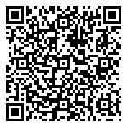
We Value Your feedback!
51
Please take a short survey about your experience:
Notes:
https://mde.qualtrics.com/jfe/form/SV_41iYKGDpUPJZgeV

Slide 52
Thank You!
517-241-5000
MDE-EducatorHelp@Michigan.gov
Notes:
For more information regarding certification, please contact our office, Monday through Thursday 8-noon and 1-5 at:
517-241-5000
OR
Monday through Friday 8-5
MDE-EducatorHelp@Michigan.gov
Thank you!

