Slide 1
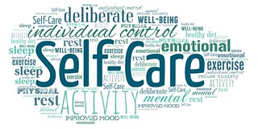
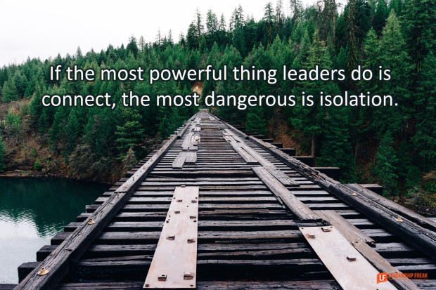


Metro Bureau
Council on Academic Leadership
January 22, 2021

Slide 2

Our Focus for Today
Touching Base with One Another
The Importance of Proactive Circles and Examples
Acknowledging Behaviors and Moving Through Stages During a Difficult Time
Understanding Brain Science and Emotions
Self-Care Resources

Slide 3

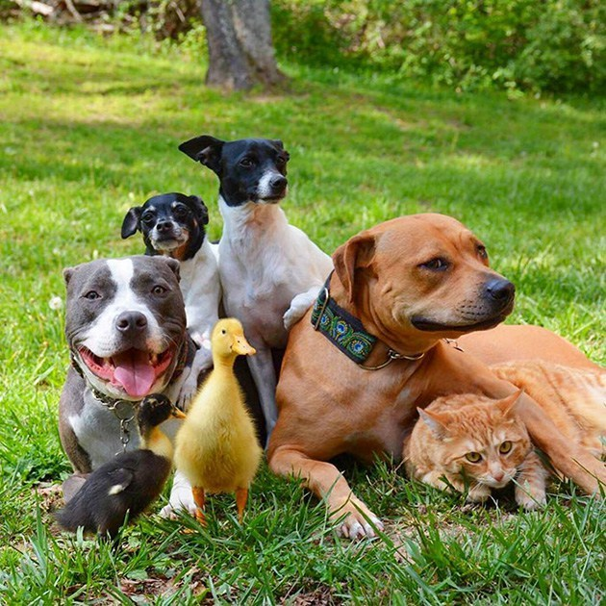
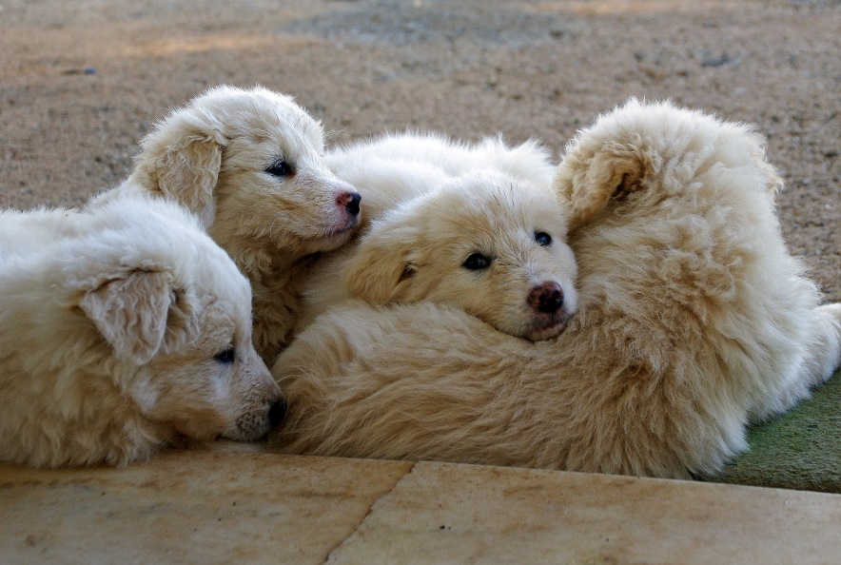



The picture that best describes my feelings about work right now is #____ because_________.
3
1
5
2
6
4

Slide 4
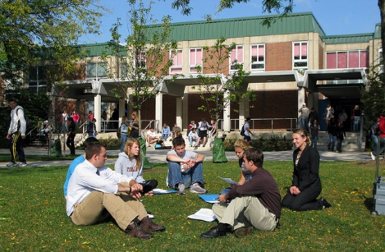
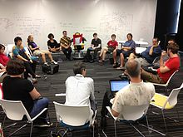
The Importance of Proactive Circles & Examples

Slide 5

One word or phrase to describe YOUR THOUGHTS OR FEELINGS this week.

Slide 6

One word or phrase that would DESCRIBE YOUR THOUGHTS OR FEELINGS During The 1ST WEEK OF the stay home, Stay safe order?

Slide 7
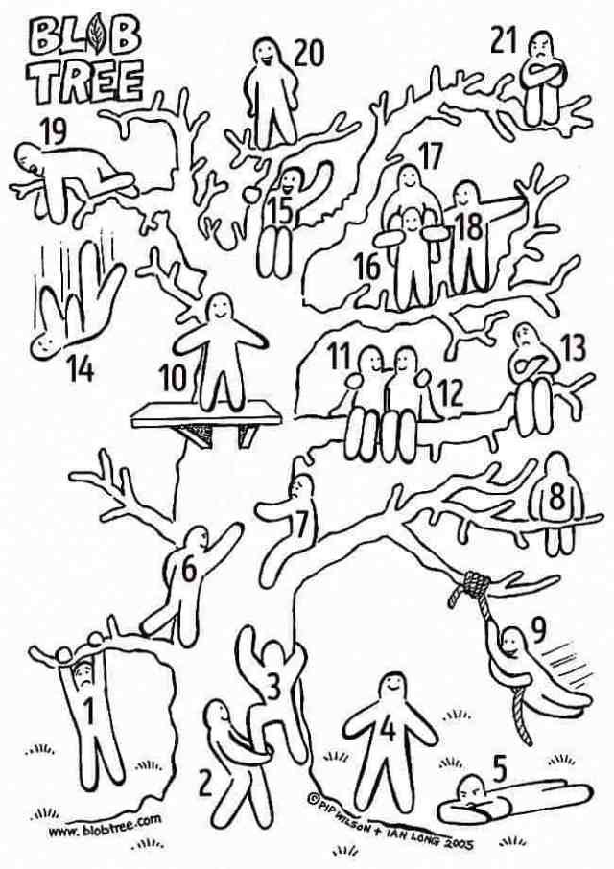
Opening Circle
Introduce yourself and your school/district and then finish this sentence:
The Blob that I feel like today is:
#____ & Why

Slide 8
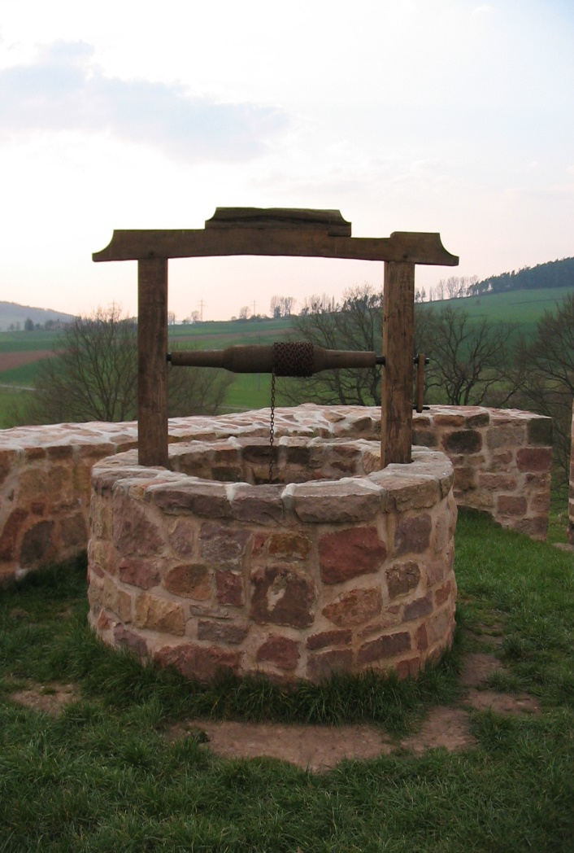

What is filling your bucket today and what’s draining it?
Filling
Draining
Notes:
Breakout rooms
Share out 2-3 whole group (see facilitators “Cliff Notes” for process, should someone become upset or distraught during this breakout session, or anytime during this PD)

Slide 9

Proactive Circle
Look at the train track and complete the following statements:
So far, my school year is on track because ___________.
I’m struggling staying on track with the challenge of __________.

Slide 10



Acknowledging Behaviors and Moving Through Stages During a Difficult Time

Slide 11
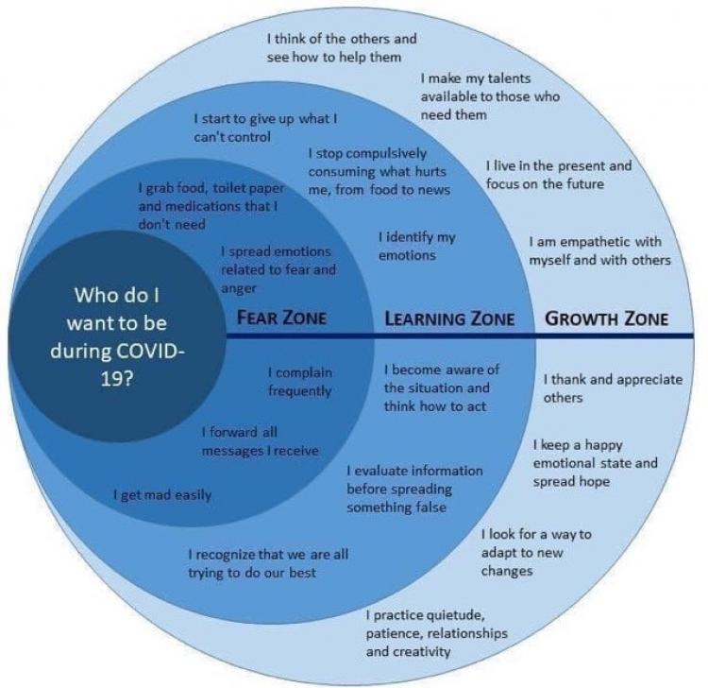
University of Colorado 2020

Slide 12
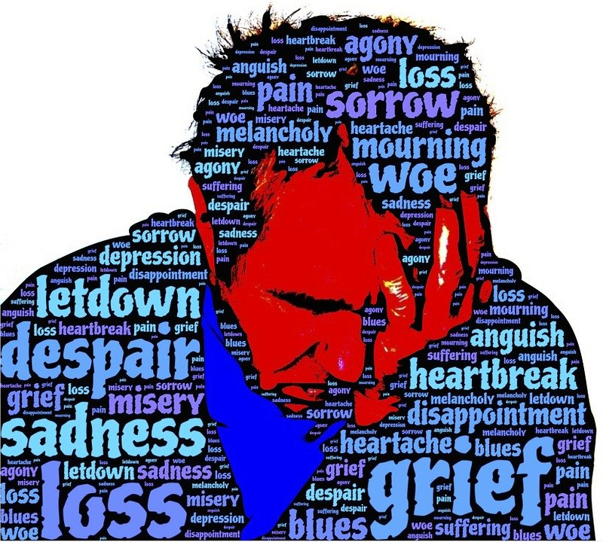
The Five Stages of Grief
Denial
Anger
Depression
Bargaining
Acceptance

Slide 13
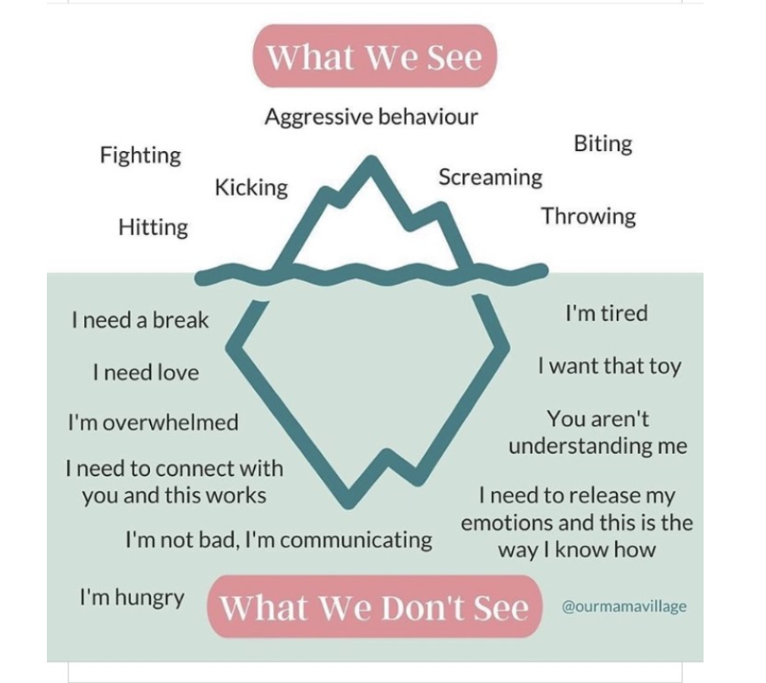

Slide 14
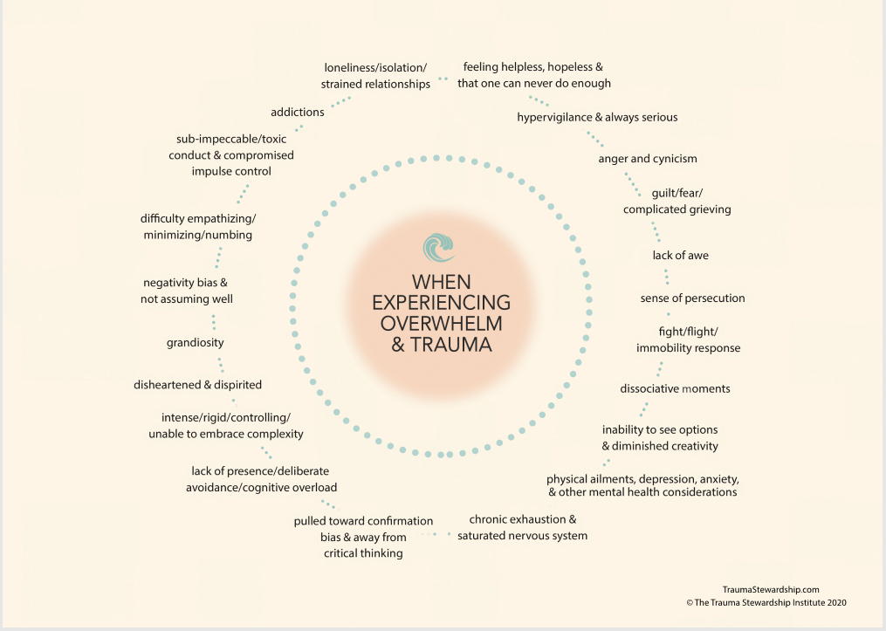

Slide 15


Understanding Brain Science & Emotions

Slide 16
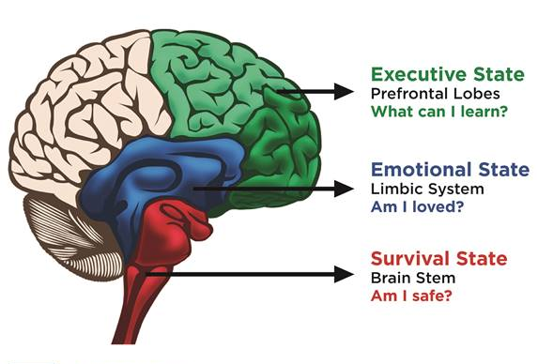
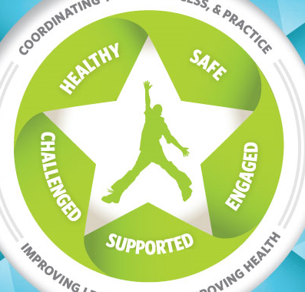
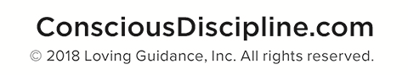
Maslow’s Hierarchy of Needs
Brain Science, WSCC, & Maslow
WHOLE CHILD TENETS
Challenged
Maximum Potential
Engaged
Self Esteem/
Recognition Needs
Supported
Love/Belonging Needs
Safe
Safety/Security Needs
Healthy
Physiological/Survival Needs
Notes:
Add the Conscious Discipline graphic as another visual…
Years ago, Abraham Maslow developed a framework of human potential to address motivation, readiness to learn and maximize human potential.
When a lower and more pressing need is satisfied humans can then shift their motivation to achieving a higher need.
Once you have your Physical / Survival Needs (food, water, temperature) – met you can move to
Security – Once your physical and emotional Safety needs are met ( you have a safe home, a safe place to go) you can focus on…
Love and Belonging – This is having a group with which you identify, (a family, a social group, peers, clubs), a need to care for someone and have them care for you in return, not just romantic love but comrade of family and friends too. When that need is met you can focus on
Self Esteem Needs –this is where you gain the respect of others, and show it in return. You form an interconnection of support
When ALL of these are met, you become
Self – Actualized – where you are able to maximize your full potential – you are moral, creative,, a problem solver and someone who seeks continued growth.
Are any of you familiar with Maslow’s work? It may be that it was part of your degree education as it was for me.
Does anyone know when Maslow developed this model? (Pause for responses)
It was 1943 (That was 74 years ago!!!)

Slide 17




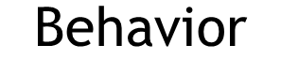
interpretation
something happens
feelings occur
action
Notes:
Something happens
The Situation is interpreted
Feelings occur as a result of the thoughts
Actions are taken in response to the feelings

Slide 18

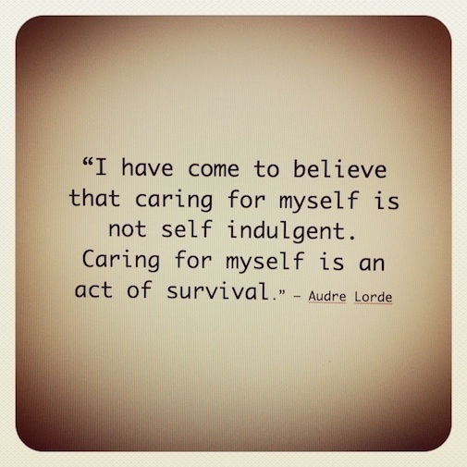

Self-Care Resources

Slide 19

Mental Health Resources
The Trauma Stewardship Institute

Slide 20
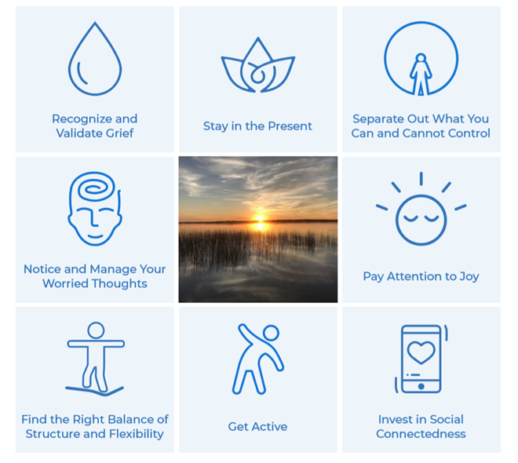
Which box will you choose to focus upon the next couple of weeks?
Who could be your accountability partner?
Notes:
Invite participants to share their commitments in the chat and write them down on a post it note so they might remember their commitments
strategies that we can do each day to grow into our learning zone and strengthen our “self regulation skills”, which is the scientific term for resilience

Slide 21

Any Questions?
Terri Czerwinski, MSN, RN
RESA School Health/Nurse Consultant
Czerwit@resa.net
734-334-1546
Linda Kell, Ed. S.
  RESA Leadership Development Consultant
  KellL@resa.net
  734-334-1573

